Slide 1
How are fossils preserved ?
Fossilisation usually depends upon two requisites, first the possession of some kind of hard parts such as a shell or skeleton, and secondly on rapid burial in a protective medium.
There are several different types of preservation of fossils:
  Unaltered soft parts
  Altered soft parts
  Unaltered hard parts
  Altered hard parts
  Trace fossils

Slide 2
Unaltered soft parts
If bacteria are excluded entirely from a dead organism, the soft parts and well as hard parts may occasionally be preserved.
There are two well known examples of this type of preservation:
  the frozen remains of mammoths in the perma-frost of Siberia, where flesh, hair and organs have all been preserved in this natural deep freeze
  secondly insects, spiders and other organisms perfectly preserved in blobs of amber, a fossil resin, secreted from the bark of ancient trees.

Slide 3
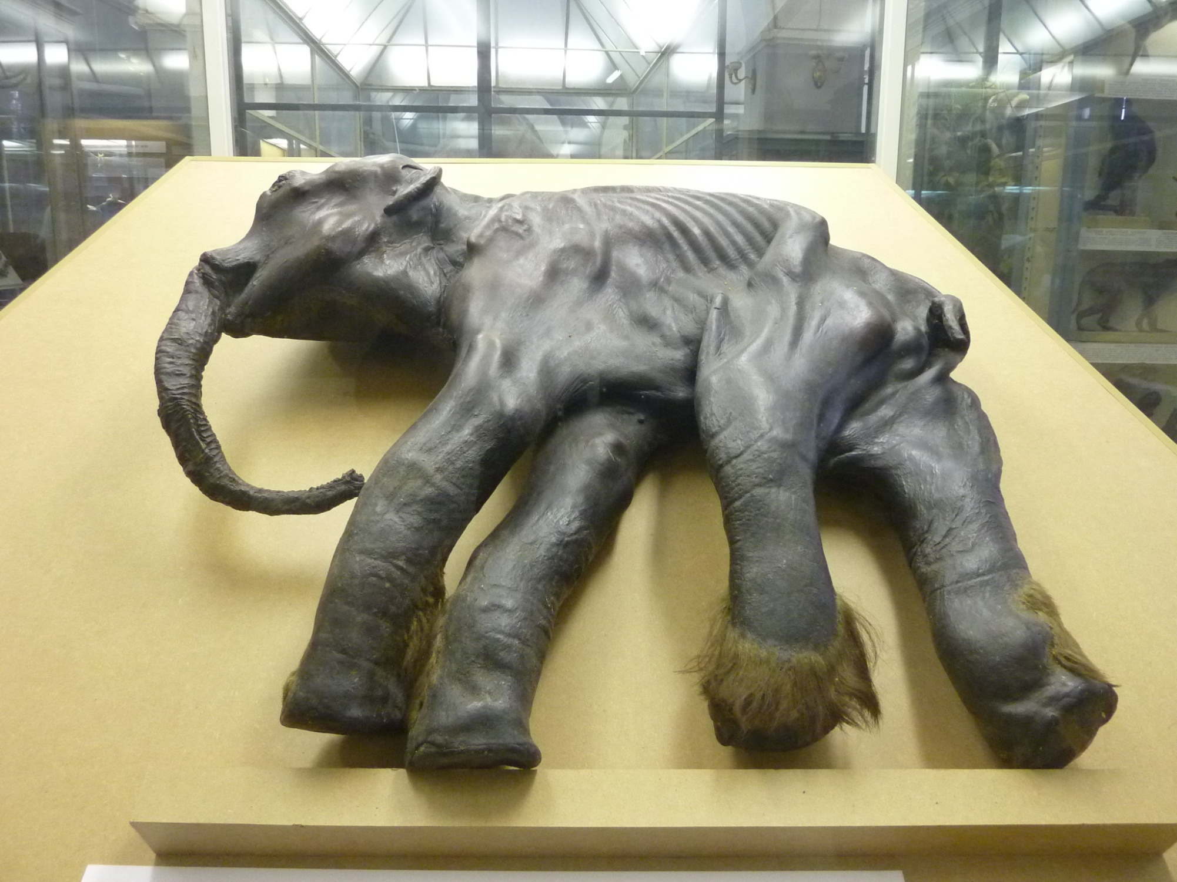
‘Dima’ – frozen baby mammoth (7 months) from Siberia

Slide 4
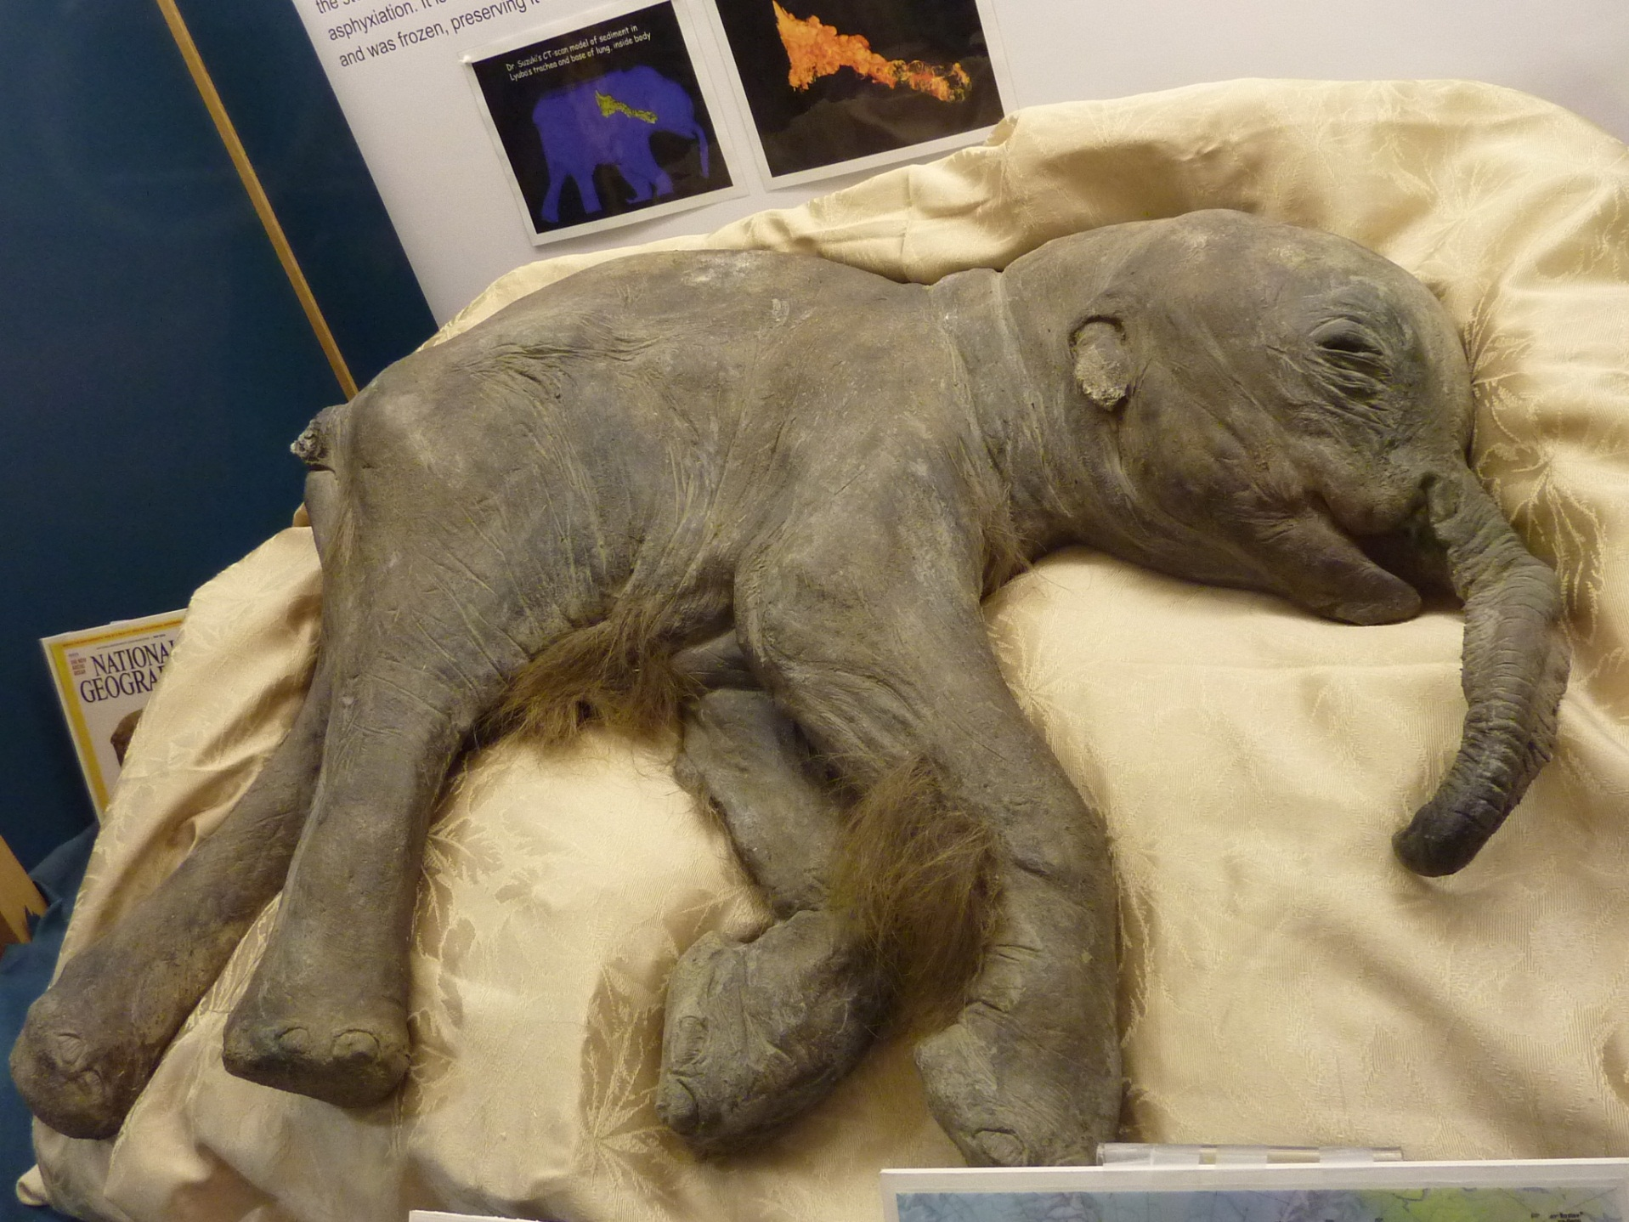
‘Lyuba’ – frozen baby mammoth (3 months) from Siberia, discovered 2007

Slide 5
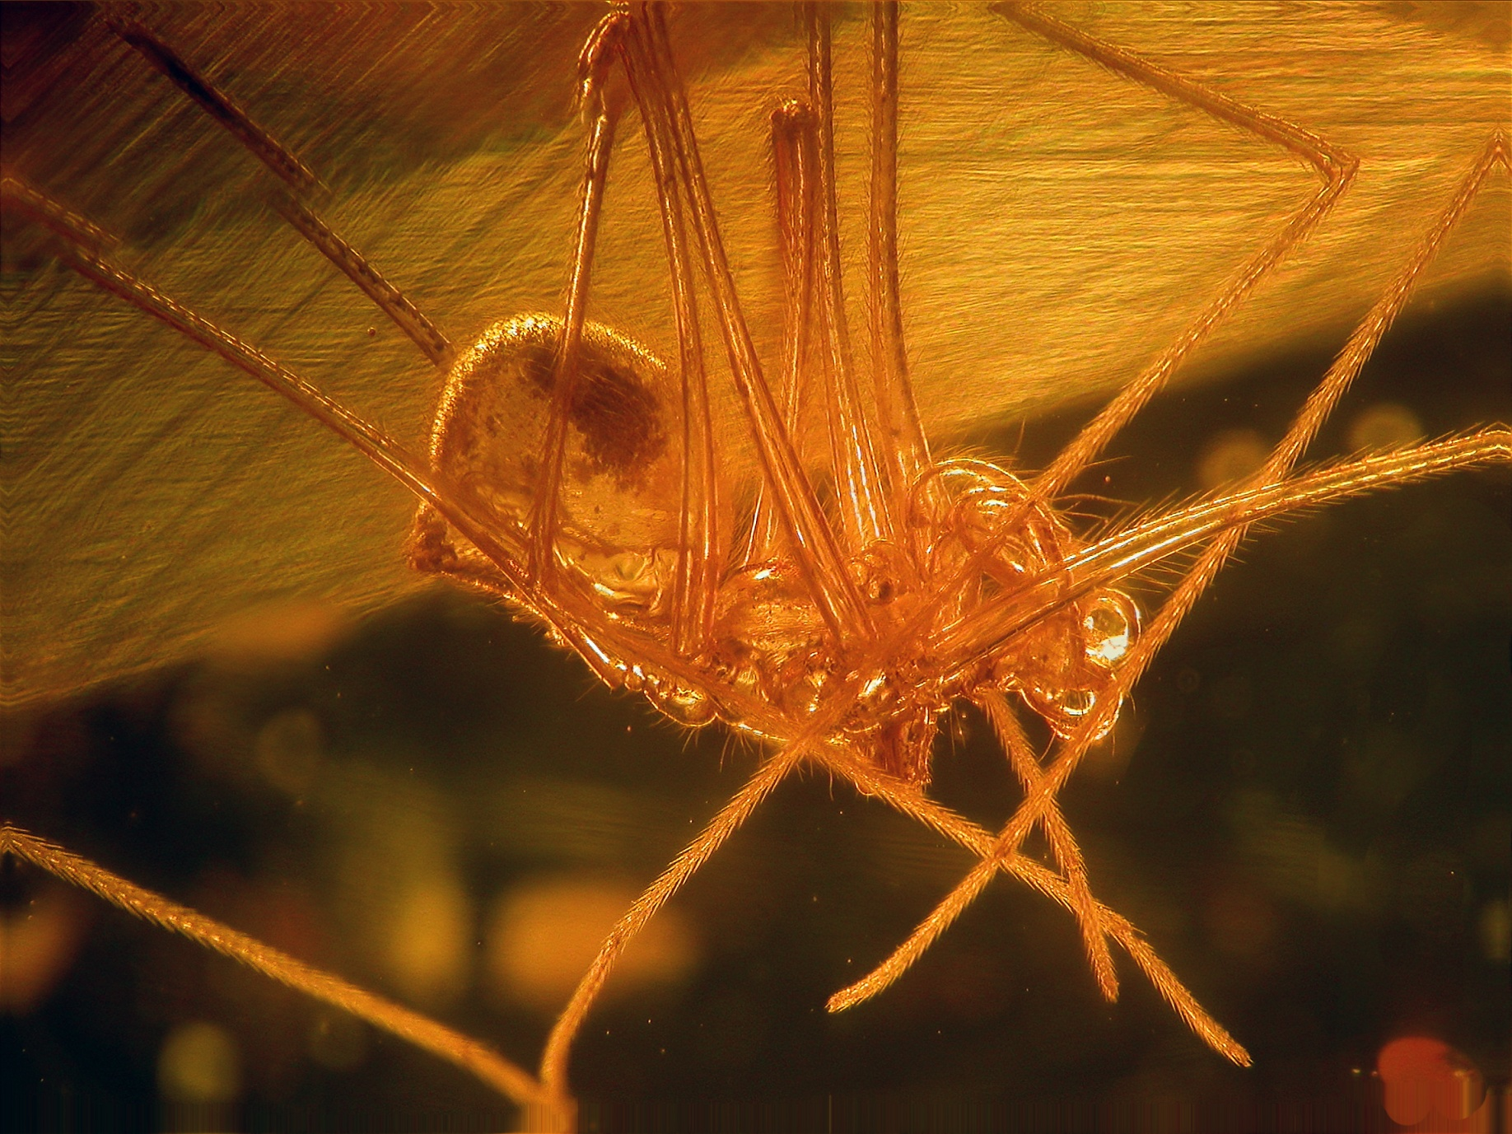
Spider in amber – note fine detail of hairs perfectly preserved

Slide 6
Altered soft parts
Soft tissue may be mineralised very early on before decomposition begins.
Very rare – examples include Burgess Shale, Solnhofen Limestone, Jehol Biota
Such examples are known as ‘Fossil Lagerstatten’ .

Slide 7
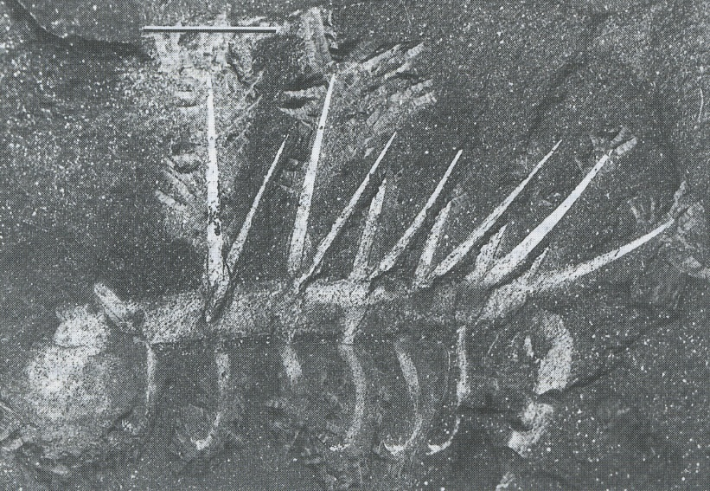
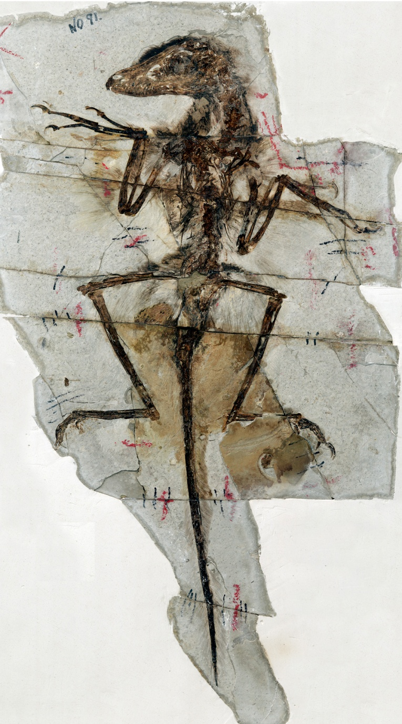
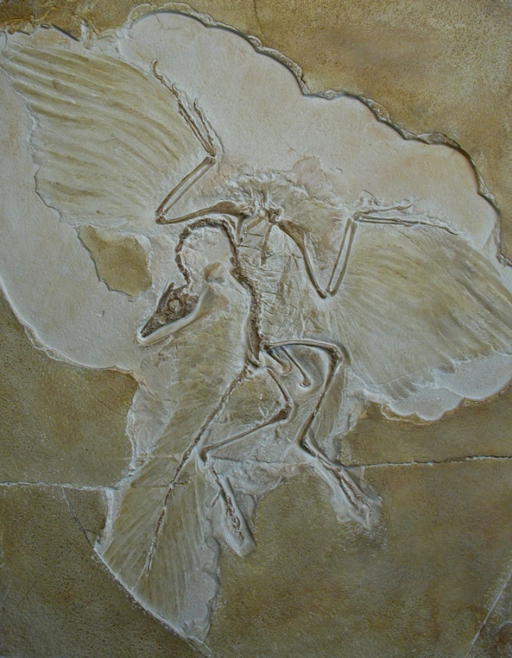
Altered soft parts
Hallucigenia – Burgess Shale
Archaeopteryx – Solnhofen Lst
Sinornithosaurus – Jehol Group

Slide 8
Unaltered hard parts
Many invertebrates and all vertebrates possess hard parts composed of calcium carbonate, calcium phosphate, silica or other complex organic compounds.
Many shells and skeletons have been preserved in the rocks with no recognisable change except for the removal of unstable organic matter.
Examples include the calcitic shells and skeletons of corals, bryozoans, most brachiopods, some molluscs and echinoderms in which original microstructure is preserved,
Also phosphatic shells of conulariids and most inarticulate brachiopods, found unaltered from the Cambrian Period onwards,
And siliceous skeletons of many sponges.

Slide 9
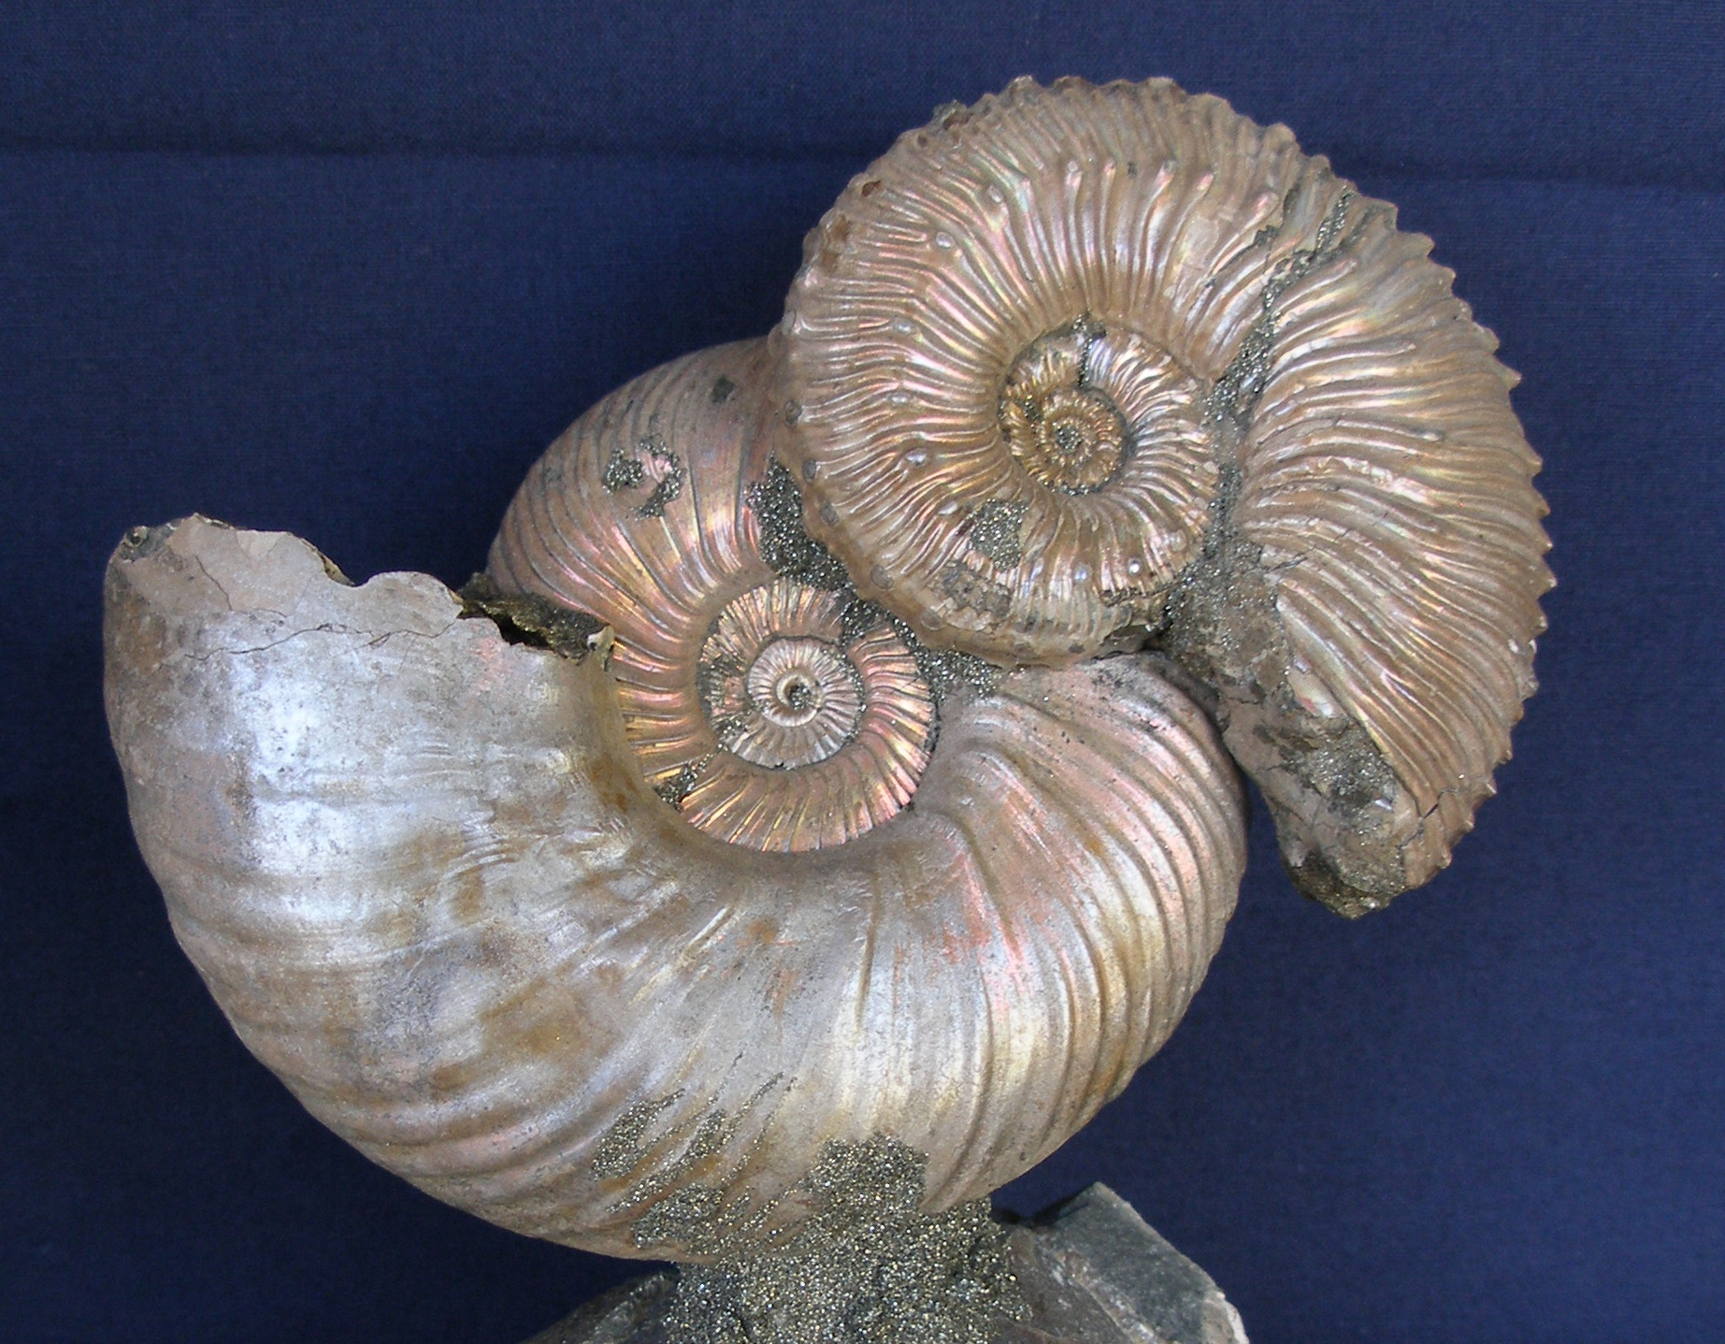
Ammonites with original “mother-of-pearl” shell

Slide 10
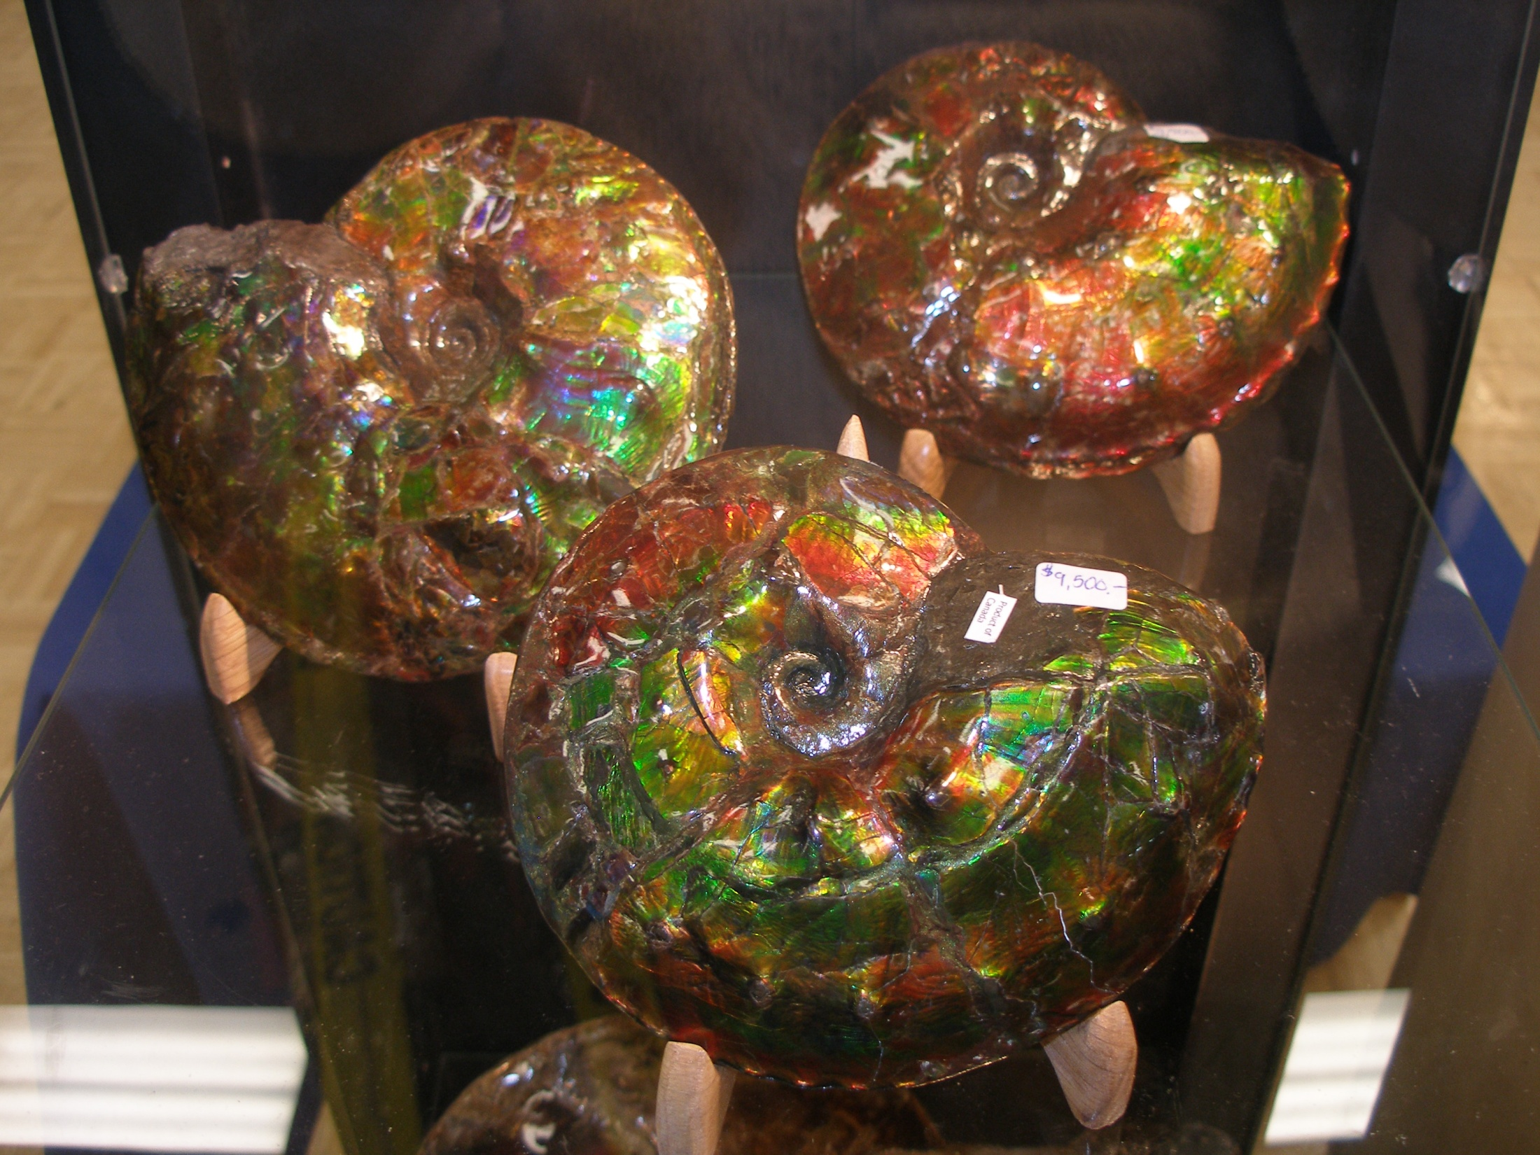
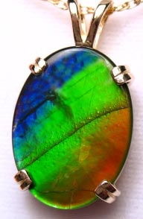
Placenticeras
Upper Cretaceous
Alberta, Canada, with original mother-of-pearl shell

Slide 11
Altered hard parts
Many fossils show varying degrees of alteration of their original structure.
This may consist only of slight rearrangement of molecules
Or may involve total removal of all original material.
There are several types of alteration:
  Carbonisation
  Petrifaction = Permineralisation
  Recrystallisation
  Replacement
  Moulds and casts

Slide 12
Carbonisation
The skeletal parts of graptolites and exoskeletons of certain arthropods were composed in life of chitinous substance (a carbohydrate).
During fossilisation the volatile organic constituents such as nitrogen, oxygen and hydrogen escaped, and the fossil is preserved as a thin film of carbon.
Fish and plants are also commonly carbonised.

Slide 13
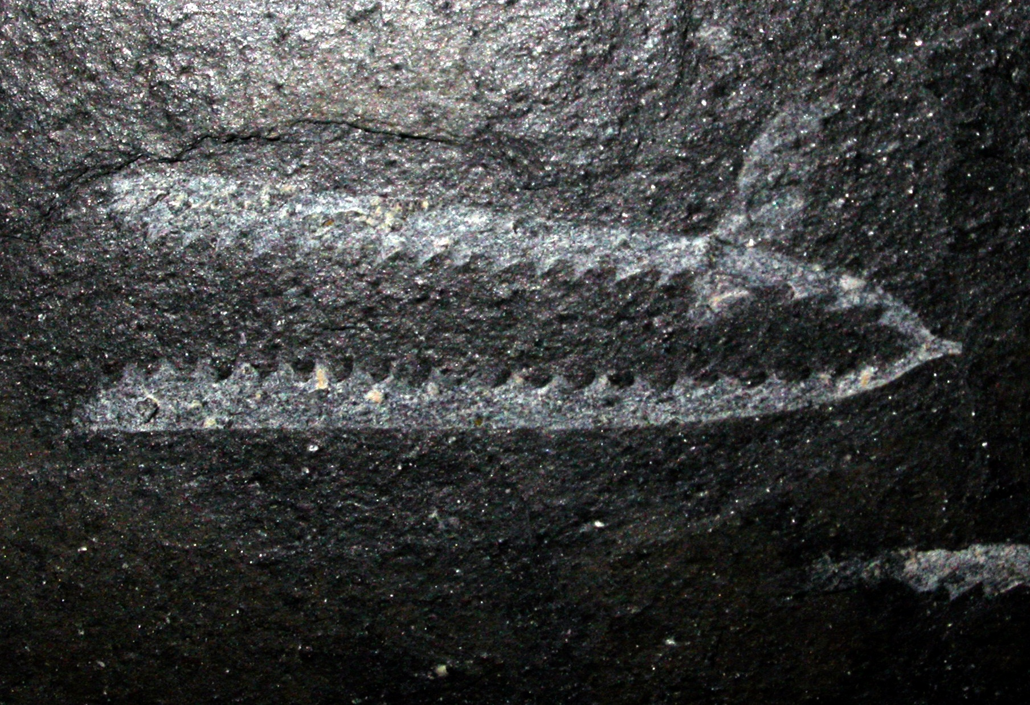
Didymograptus (a graptolite) preserved as a thin film of carbon

Slide 14
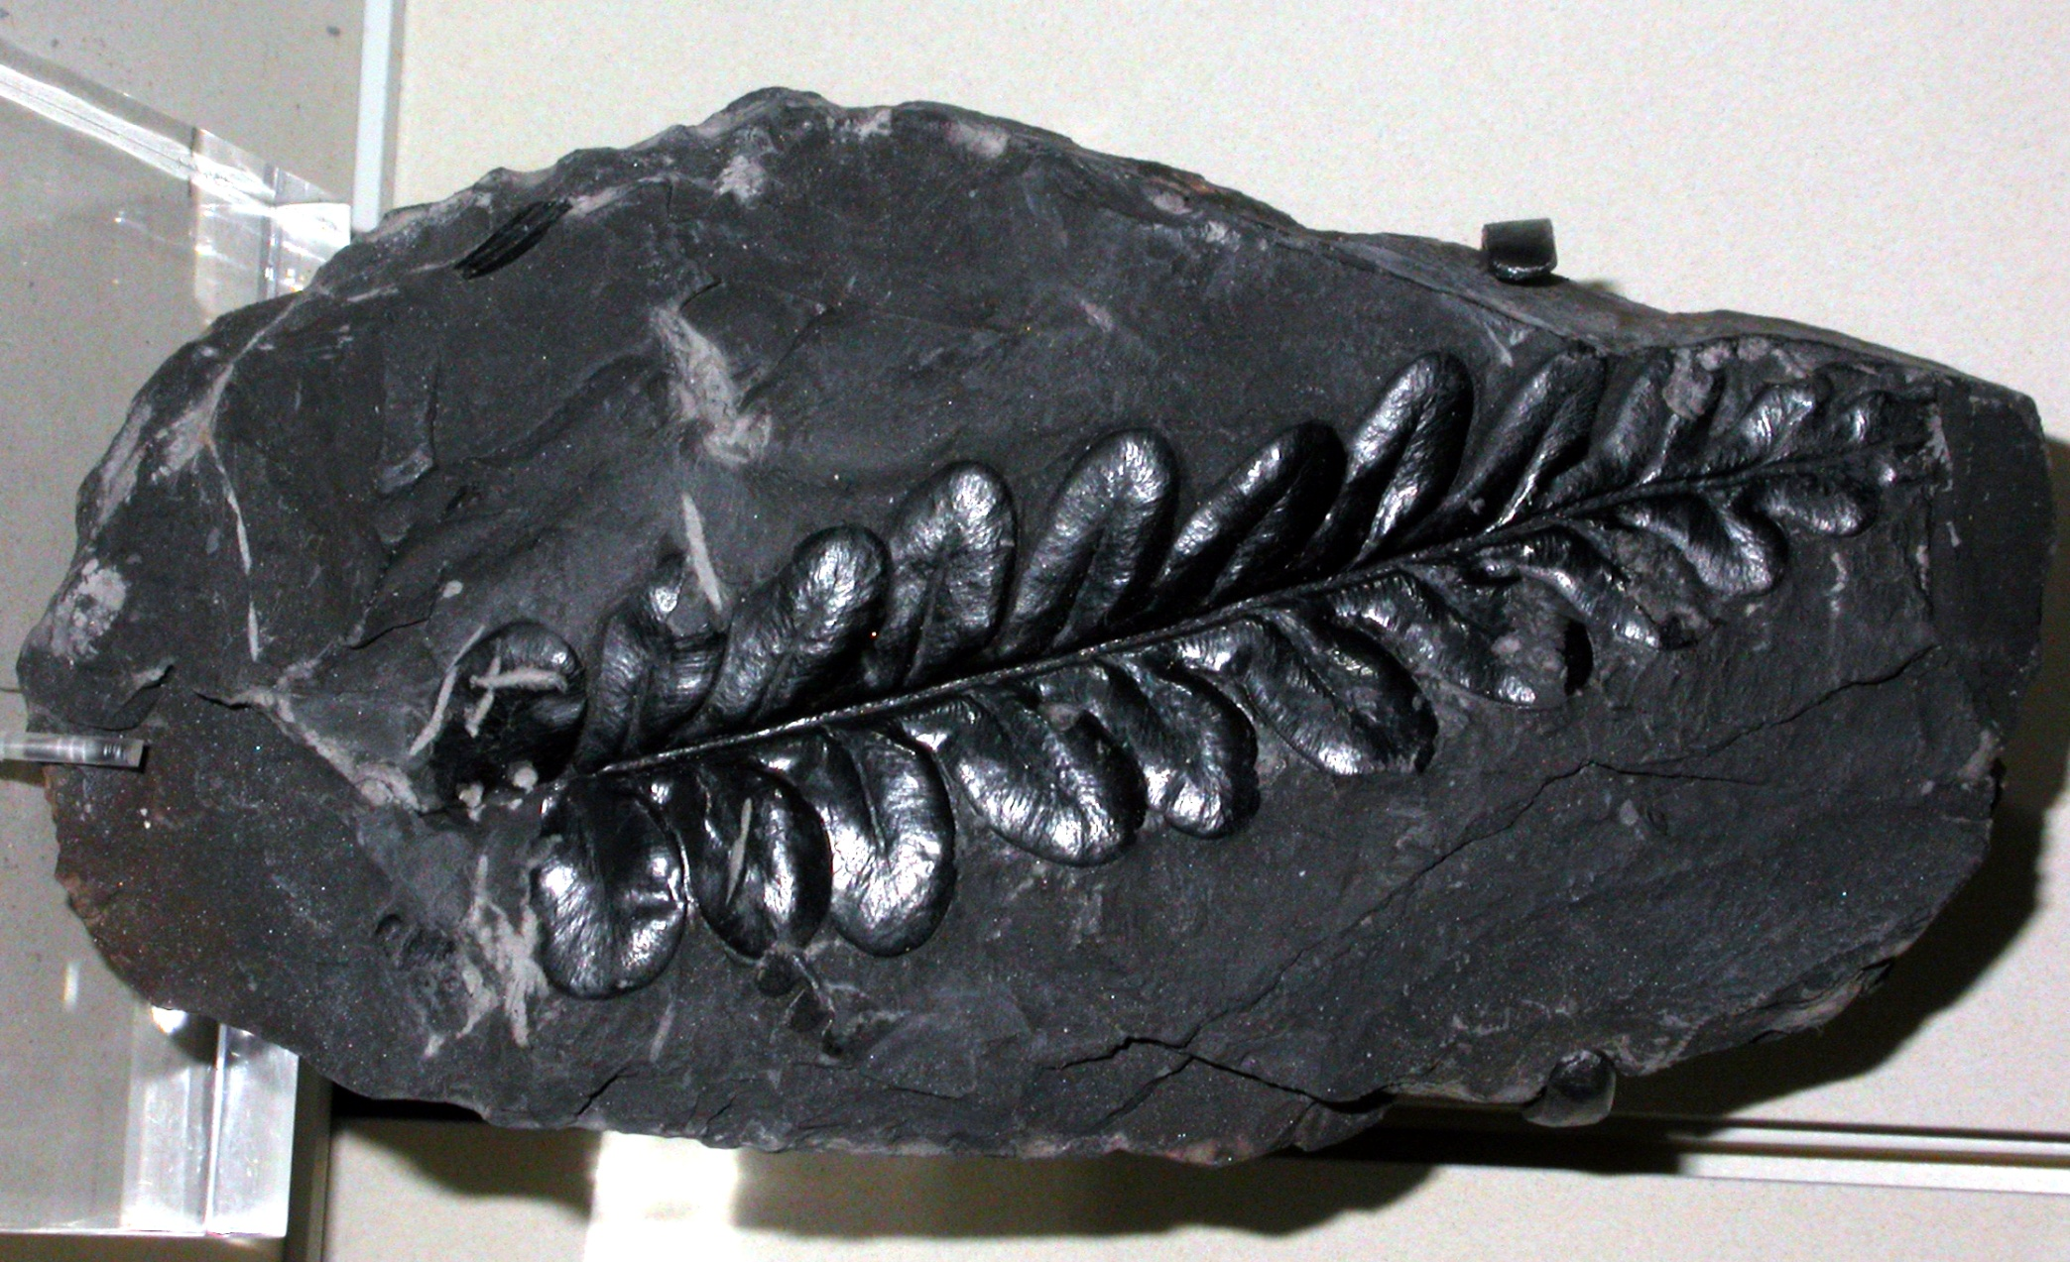
Alethopteris (a plant) preserved as a thin film of carbon

Slide 15
Petrifaction or permineralisation
Shells, bones and plant tissue which are porous may be made more dense by deposition of mineral substances from percolating ground waters within the pores.
Hard parts altered in this way are permineralised or petrified.
Common examples include petrified wood or bone in which original cellular structure can still be seen.

Slide 16
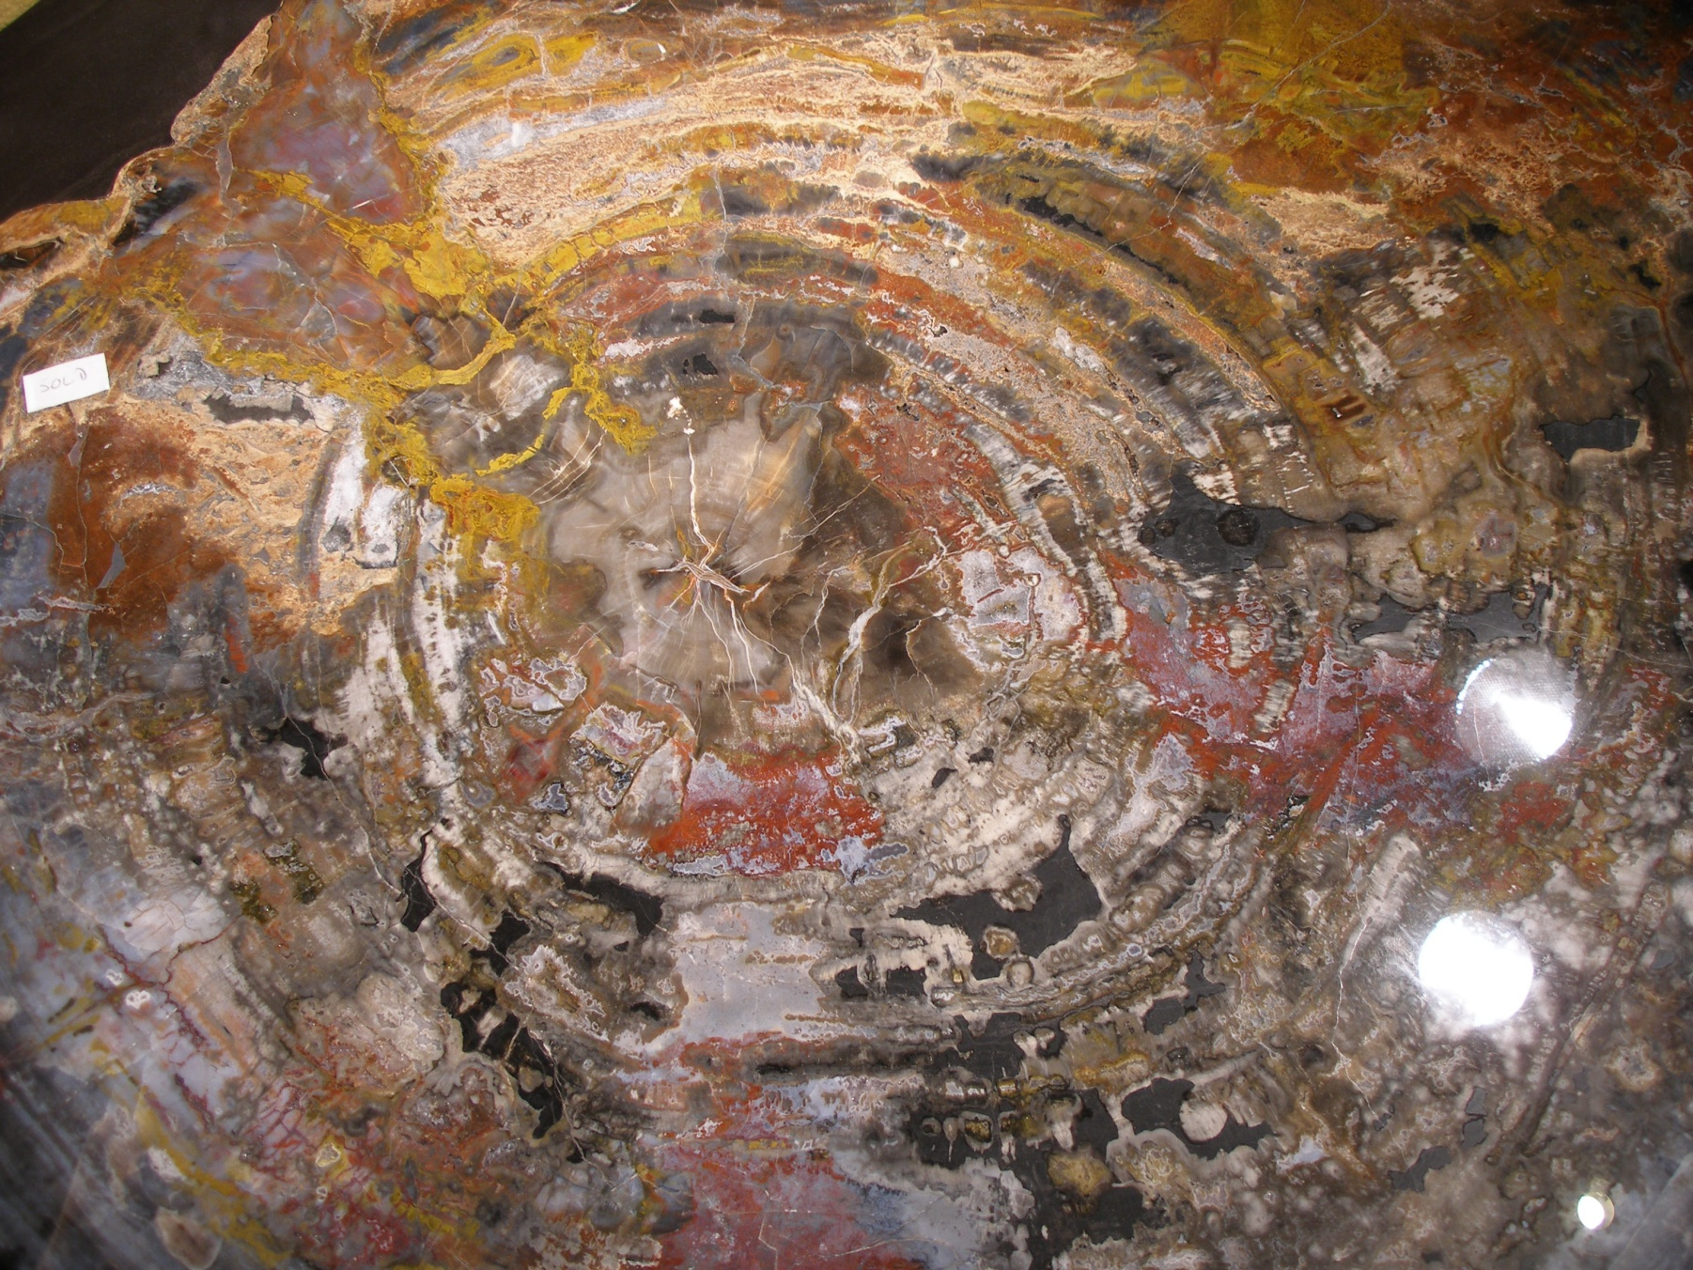
Fossil wood from the Petrified Forest of Arizona showing permineralisation

Slide 17
Recrystallisation
The internal physical structure of some shells may be changed by shuffling of molecules as the result of solution and reprecipitation.
Recrystallisation commonly maintains the original mineral composition or it may involve change from one mineral to another of similar chemical composition but different molecular structure.
The classic example concerns Mesozoic coral skeletons which were originally composed of aragonite (an unstable form of calcium carbonate). In their fossils the molecules have regrouped into calcite, a more stable form of calcium carbonate. The original microstructure is completely lost and the shell is converted into a mosaic of interlocking crystals.

Slide 18
Replacement
Solution of the shell or skeleton, coupled with the simultaneous deposition of some other mineral substance in the resulting voids, leads to replacement.
Original microstructure may or may not be preserved.
Examples include pyritisation, hematisation, silification, calcification, and finally fluoritisation.

Slide 19
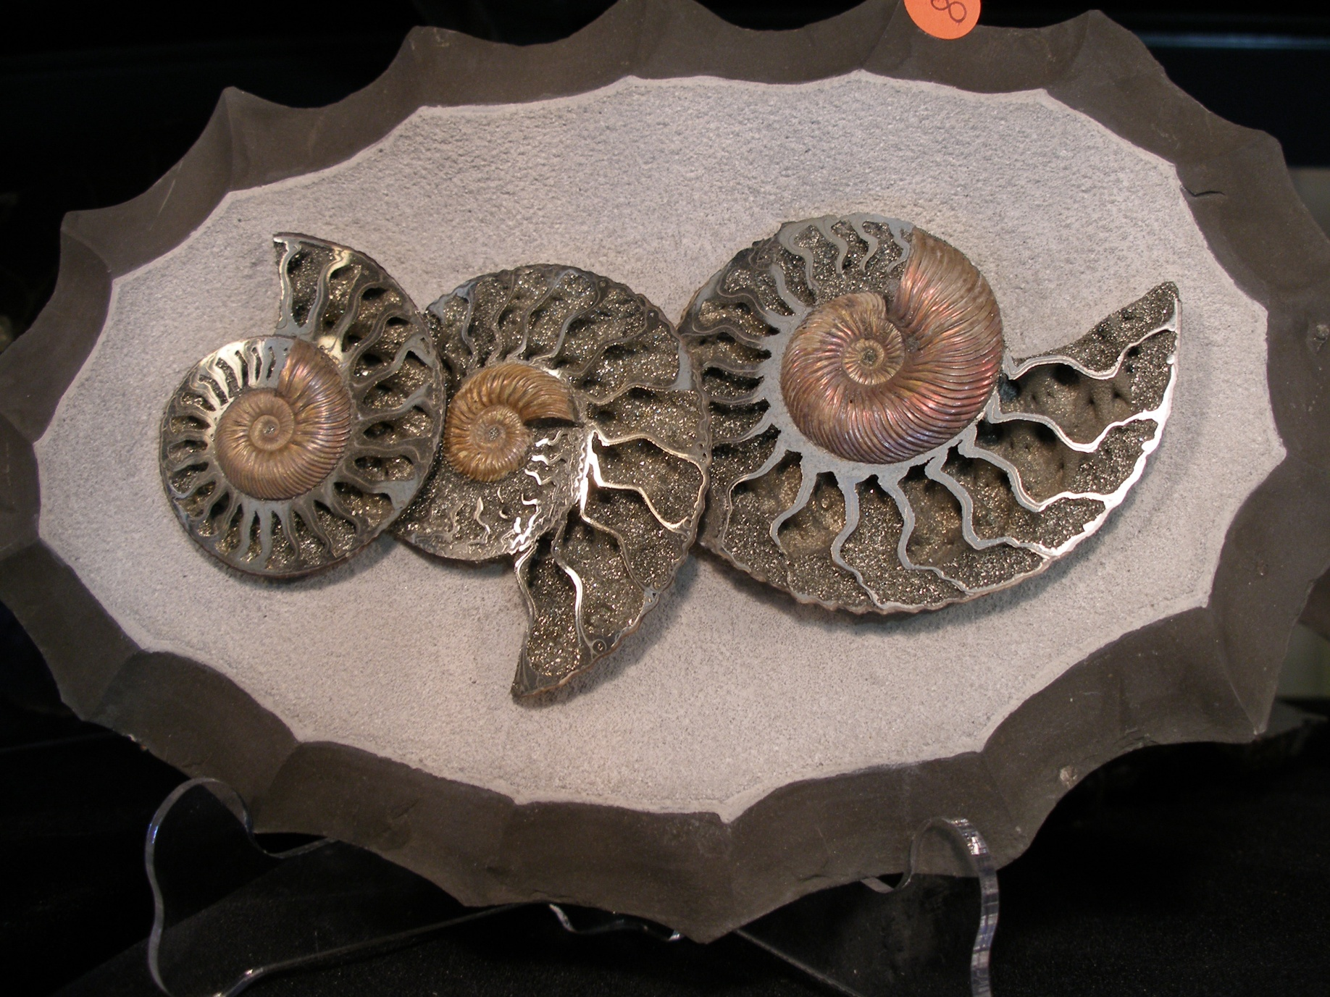
Pyritised ammonites from Germany

Slide 20
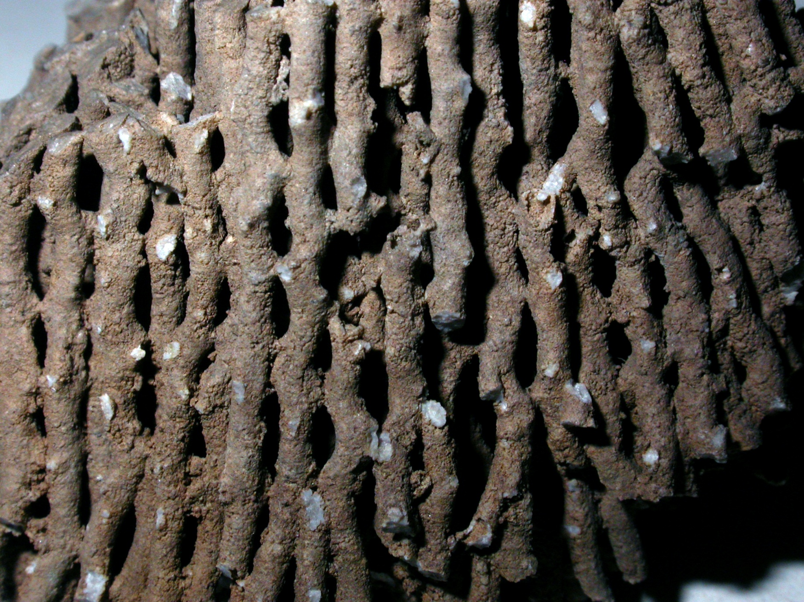
Silicified coral (Syringopora) from the Lower Carboniferous of Derbyshire

Slide 21
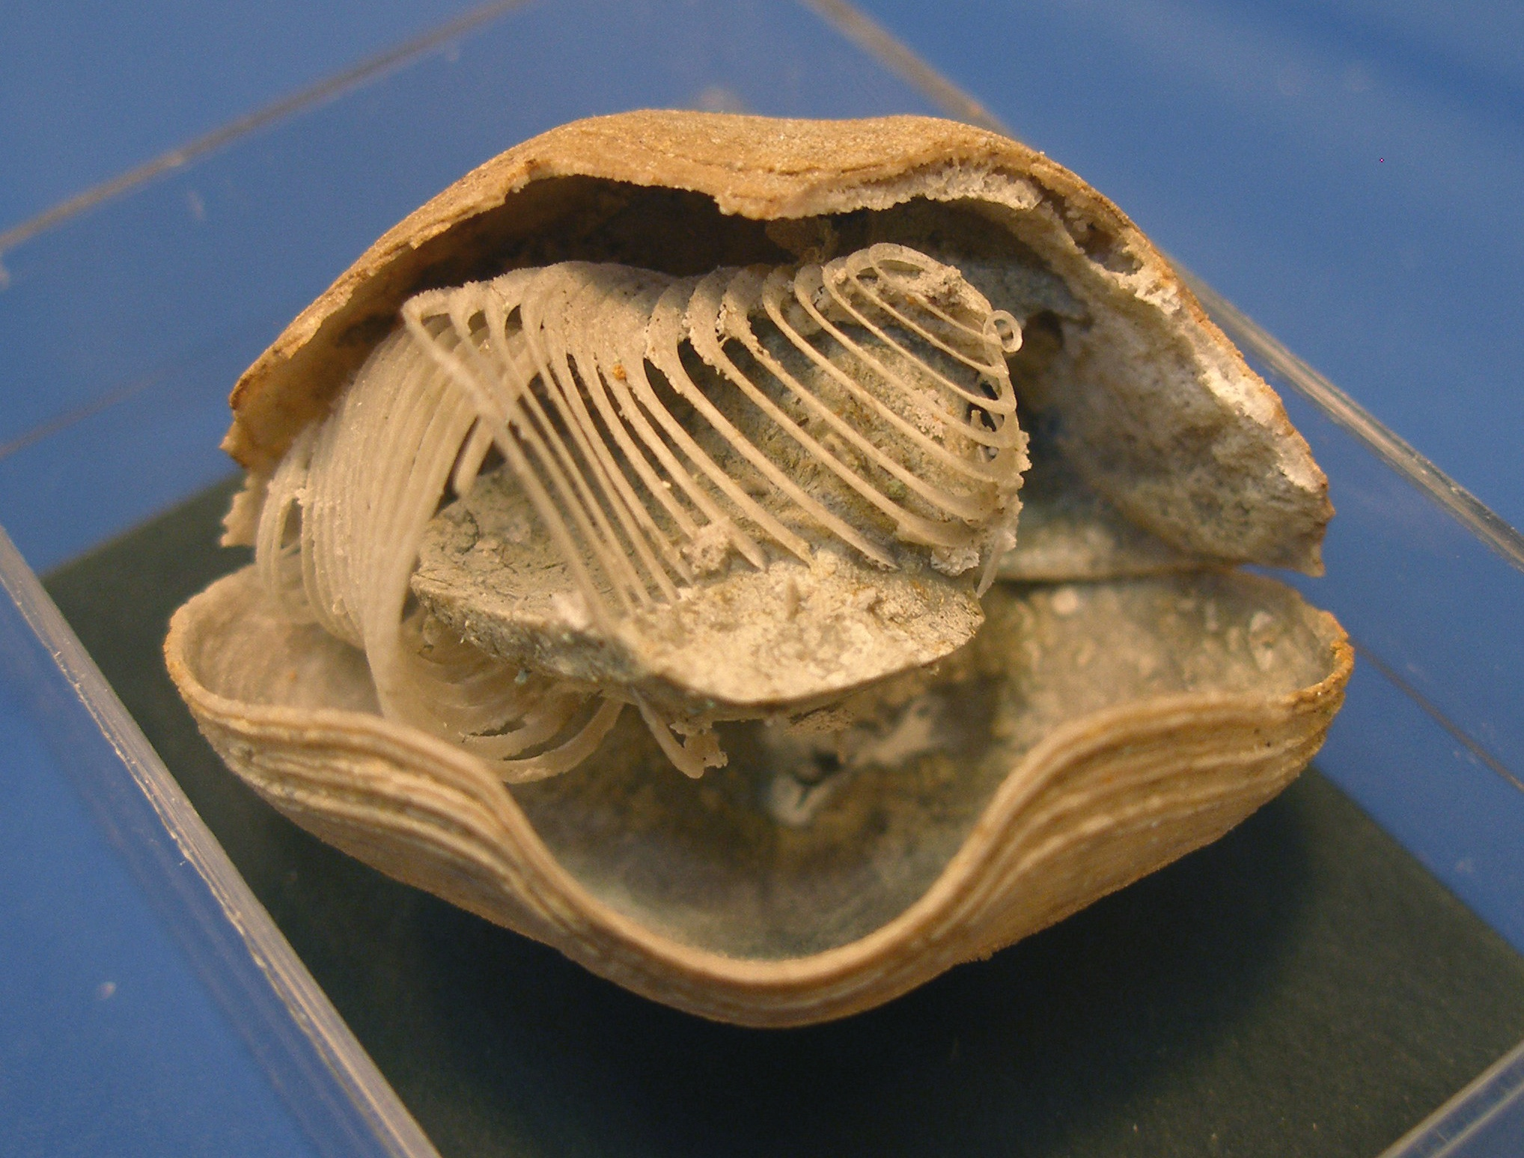
Silicified brachiopod (Spirifer) from the Lower Carboniferous of USA

Slide 22
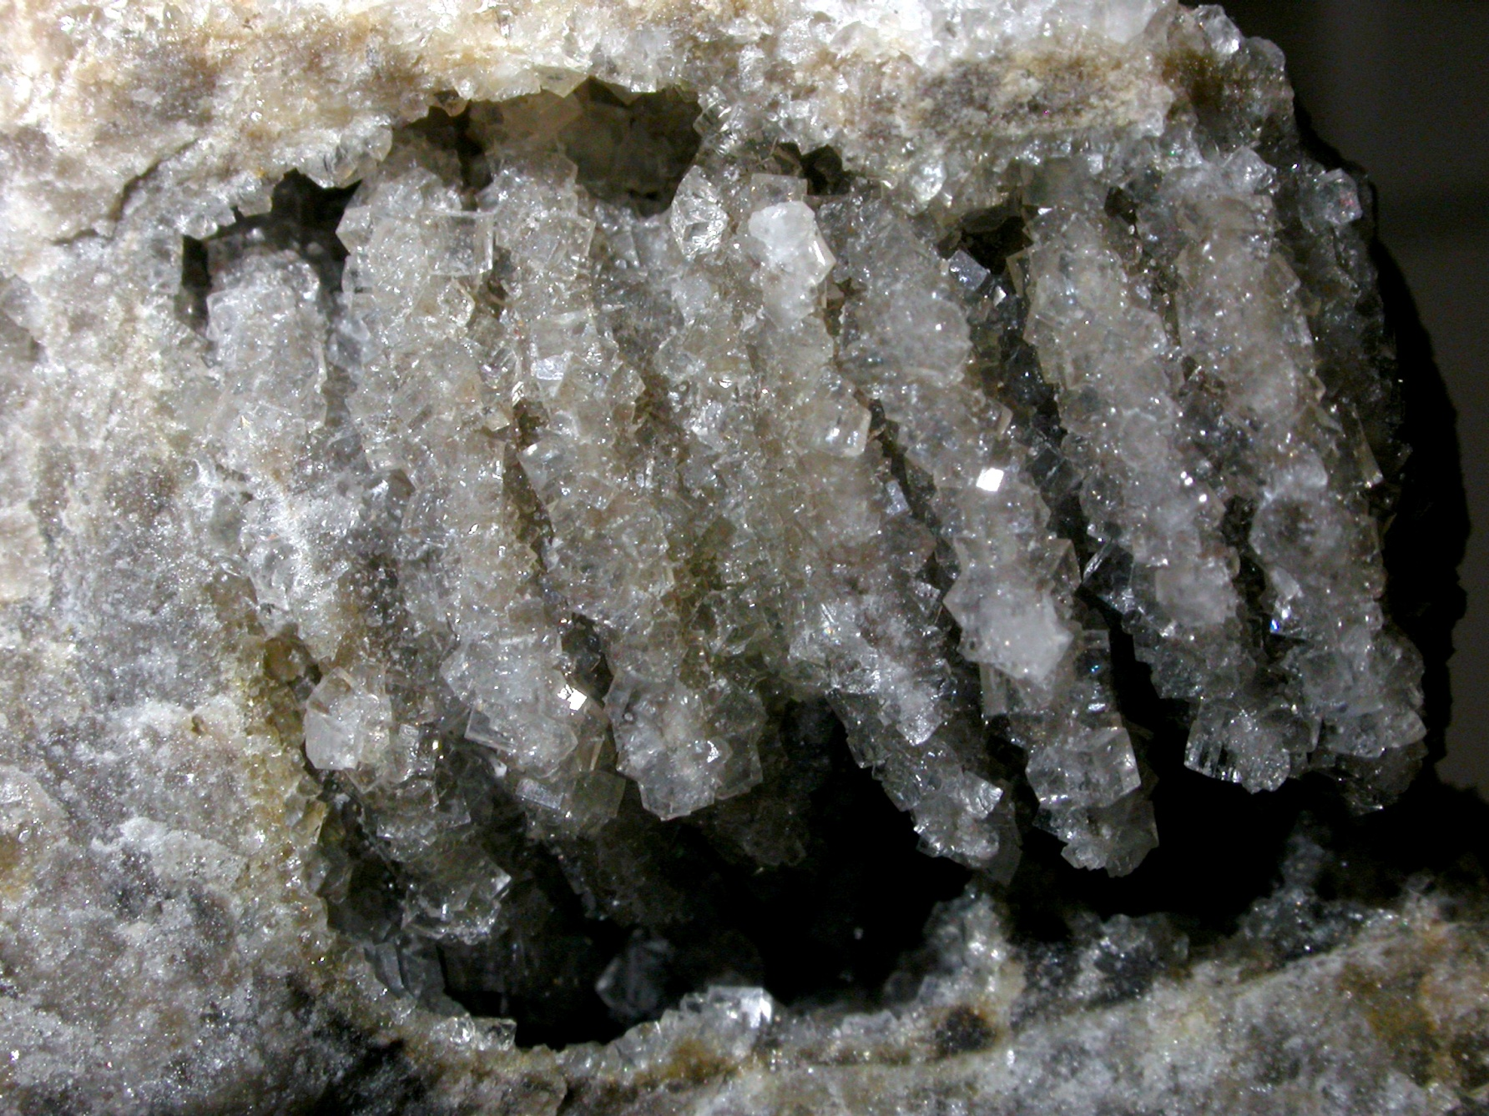
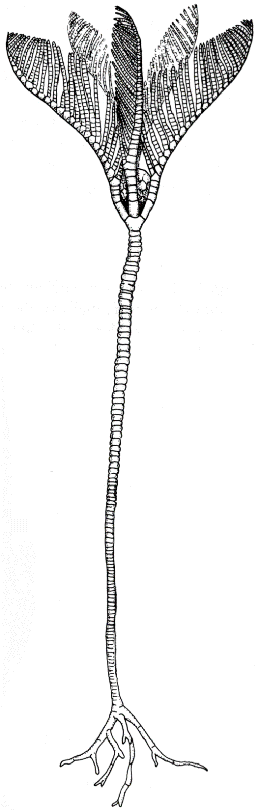
Fluoritised crinoid from the Lower Carboniferous of Derbyshire

Slide 23
Moulds and casts
Imagine a mollusc shell lying on a beach and getting buried in the sand. The sand will be packed closely around it, and also will fill the internal shell cavity.
After millions of years when the sand has lithified, the impression of the shell within the sandstone constitutes an external mould (it shows the external features in reverse).
The inner core of sandstone is known an internal mould, or as a steinkern (and also preserves the features in reverse).
If the original shell is removed by solution and the resulting void is subsequently filled by mineral matter, it forms a natural cast, which may also show external and/or internal features.

Slide 24
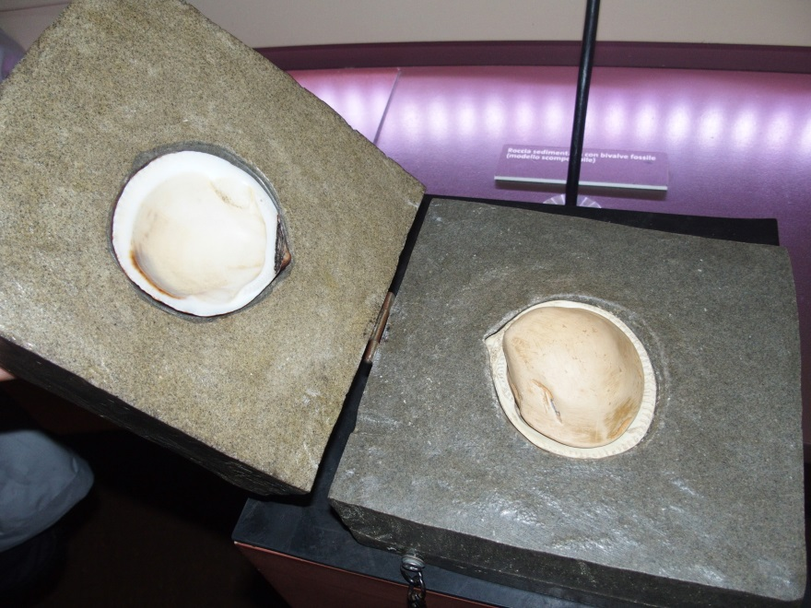
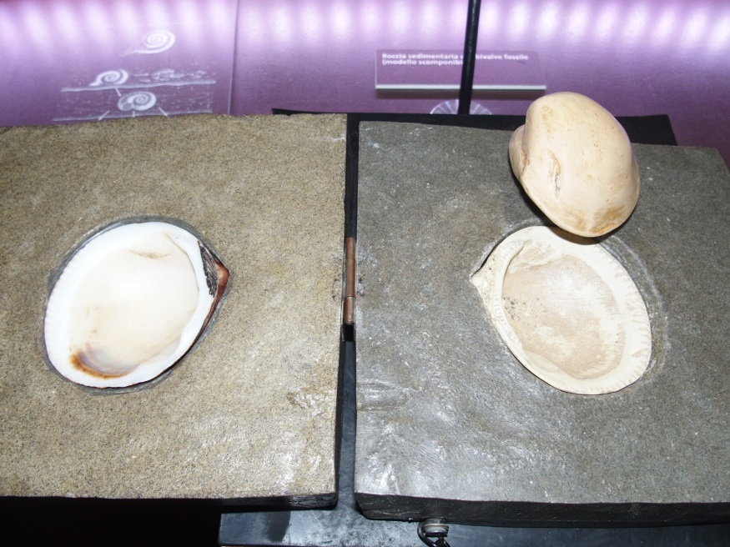
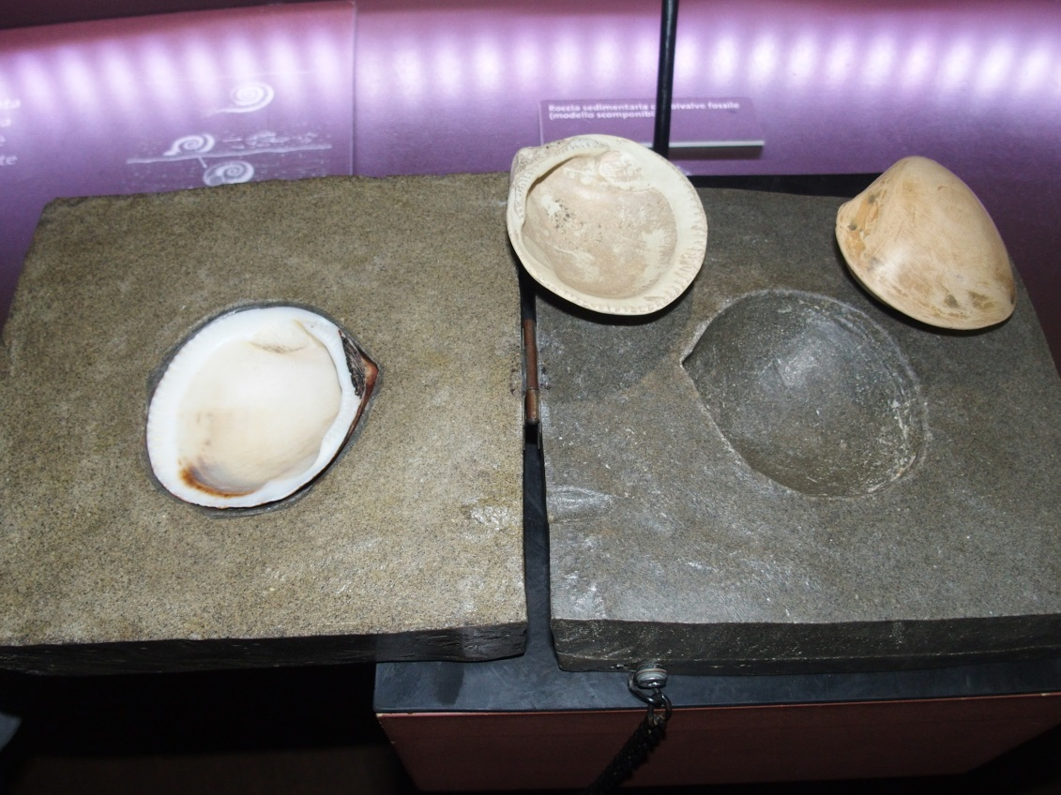
Moulds and casts – internal and external

Slide 25
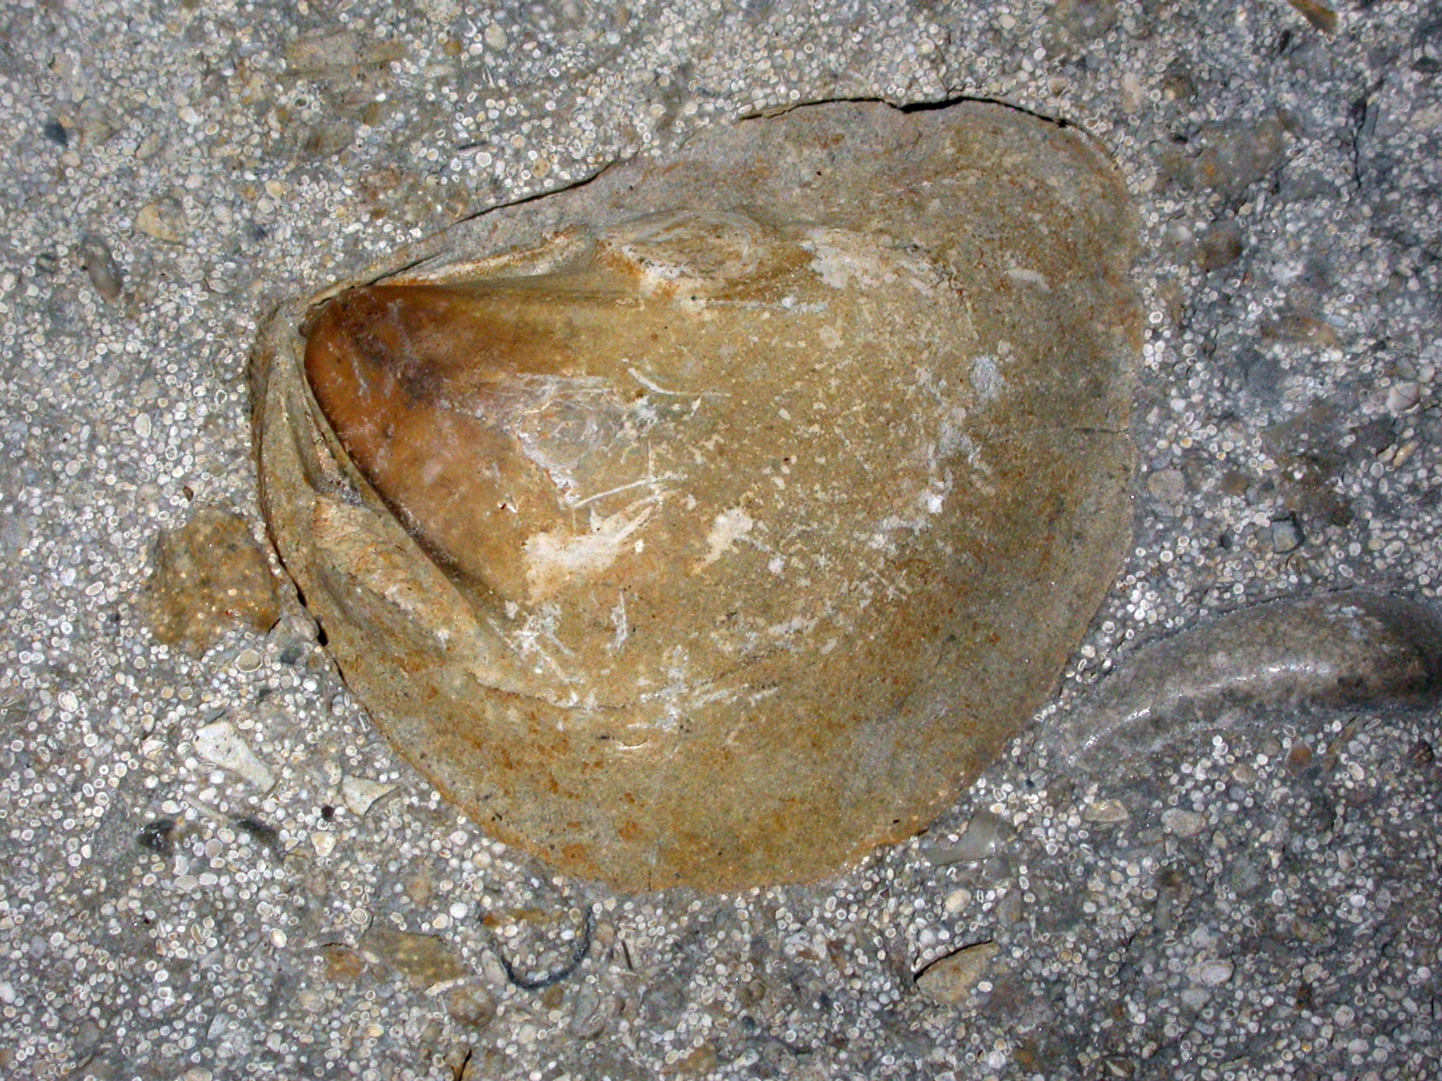
Internal mould of a bivalve (Trigonia) from the Jurassic Stonesfield Slate

Slide 26
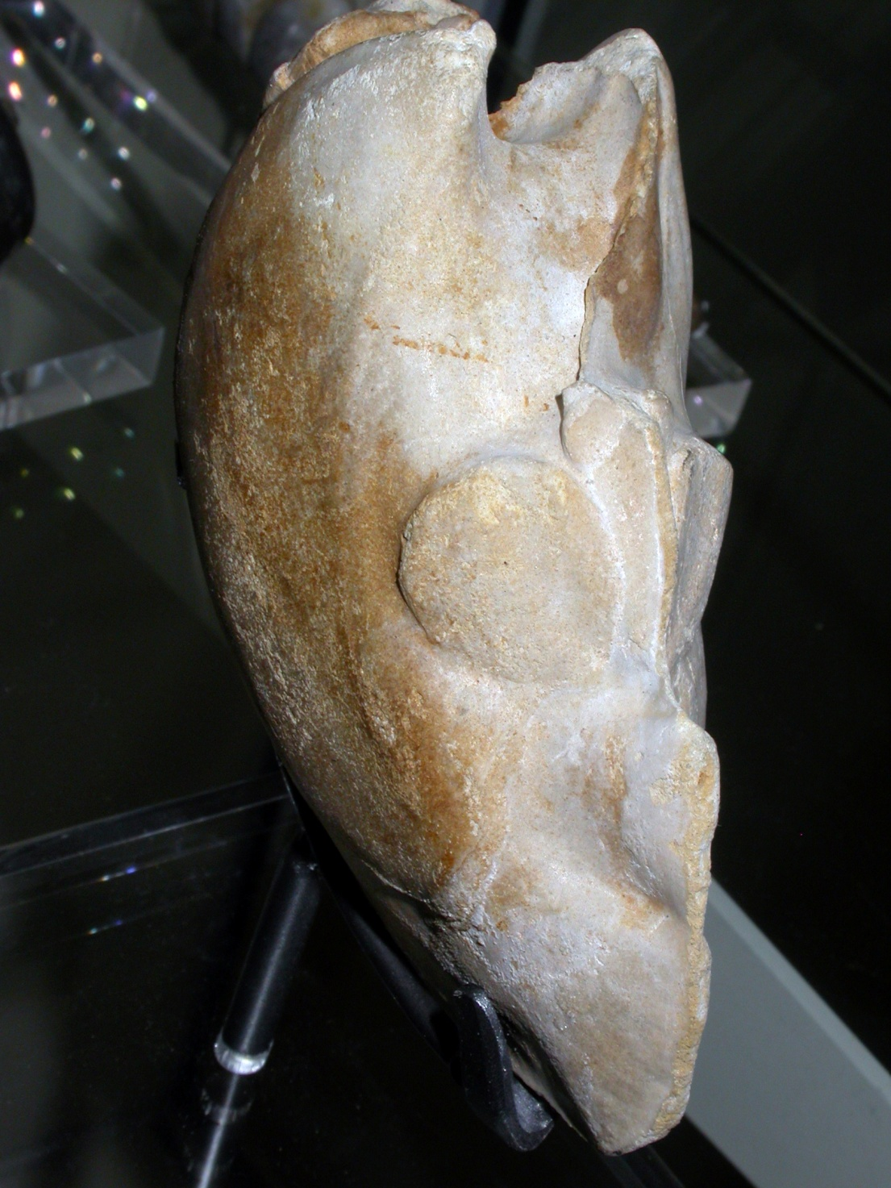
Internal mould of a bivalve (Trigonia) from the Jurassic Stonesfield Slate
‘Orses ‘eads’

Slide 27
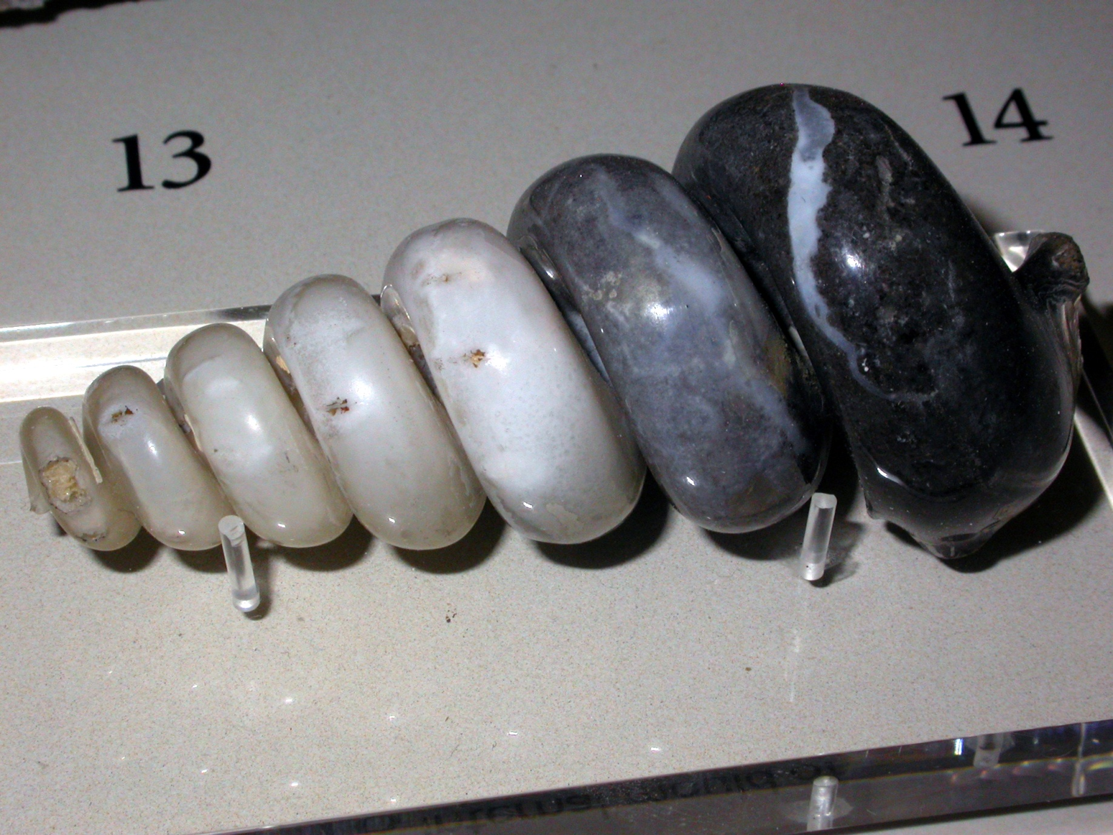
Internal mould of a gastropod (snail)

Slide 28
Trace Fossils
All of the previous examples are known as body fossils as they constitute the actual remains of animals or plants.
Trace fossils comprise evidence of the activity of animals or plants and include trails and footprints made by the feet and tails of animals, burrows made by animals in soft sediment, borings in hard substances, impressions in sediment made by a resting animal etc.
Other interesting trace fossils are coprolites, the fossils excrement of animals, which may be informative, especially when they contain the remains of food.

Slide 29
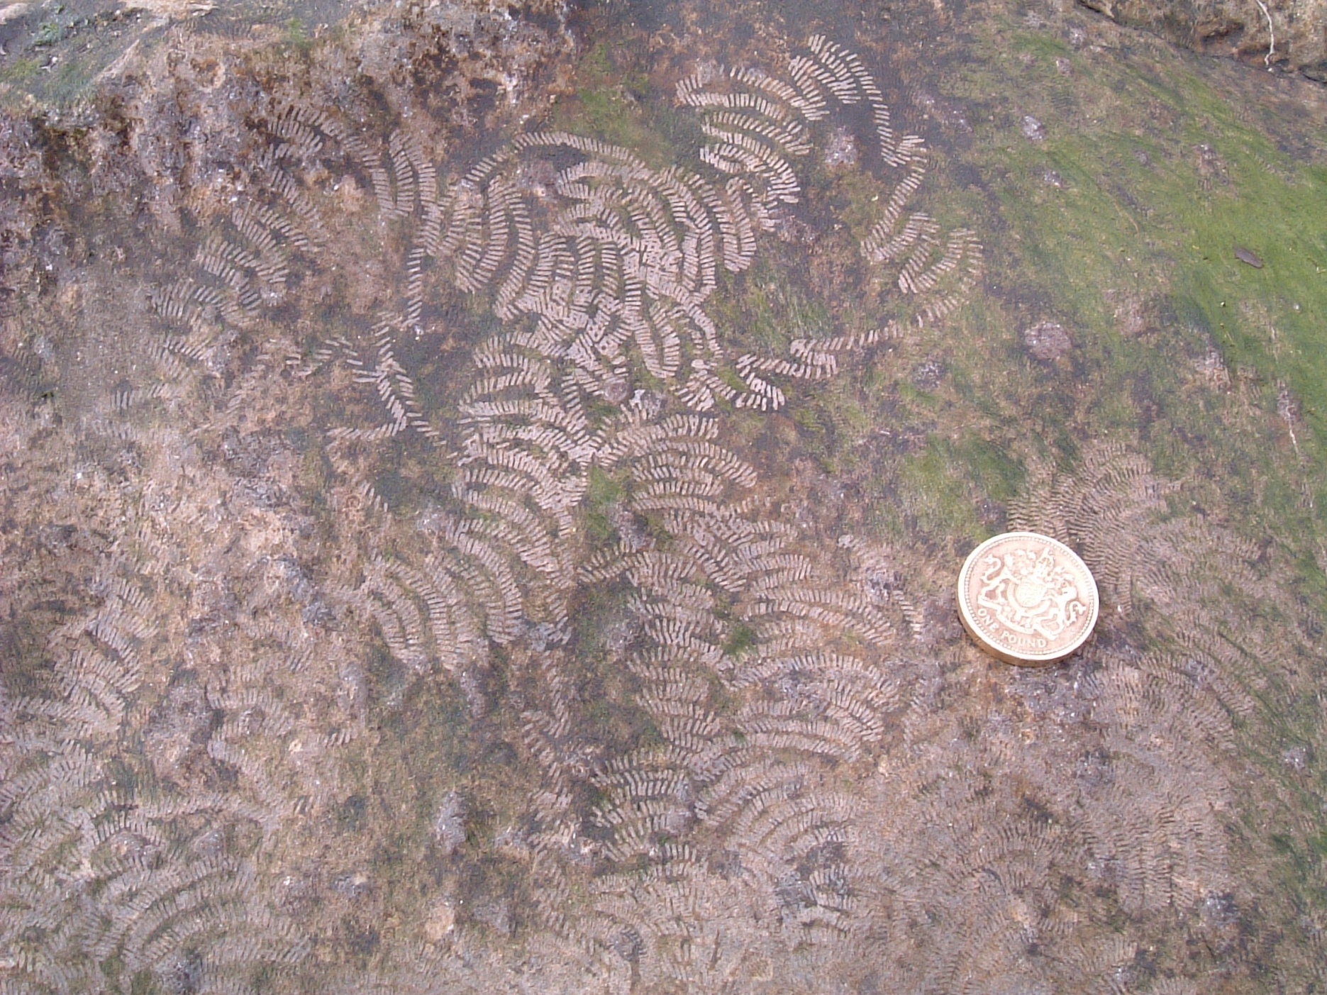
Living gastropod feeding trail, Kirkcaldy, Scotland.

Slide 30
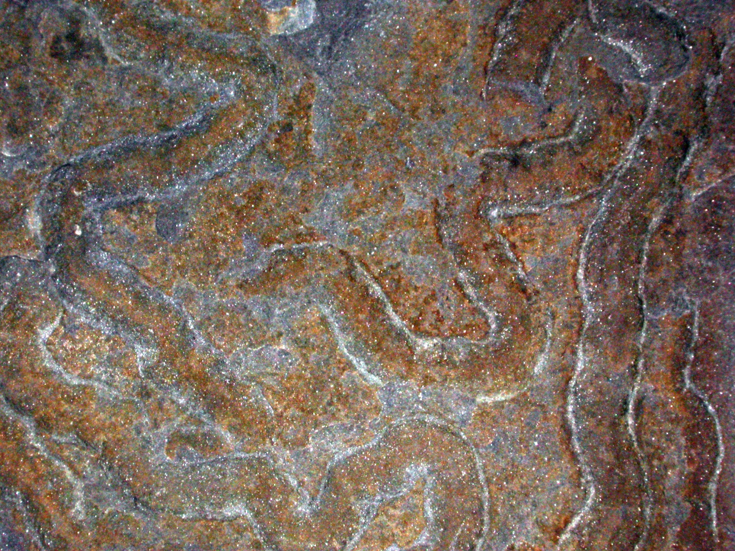
Fossil gastropod feeding trail

Slide 31
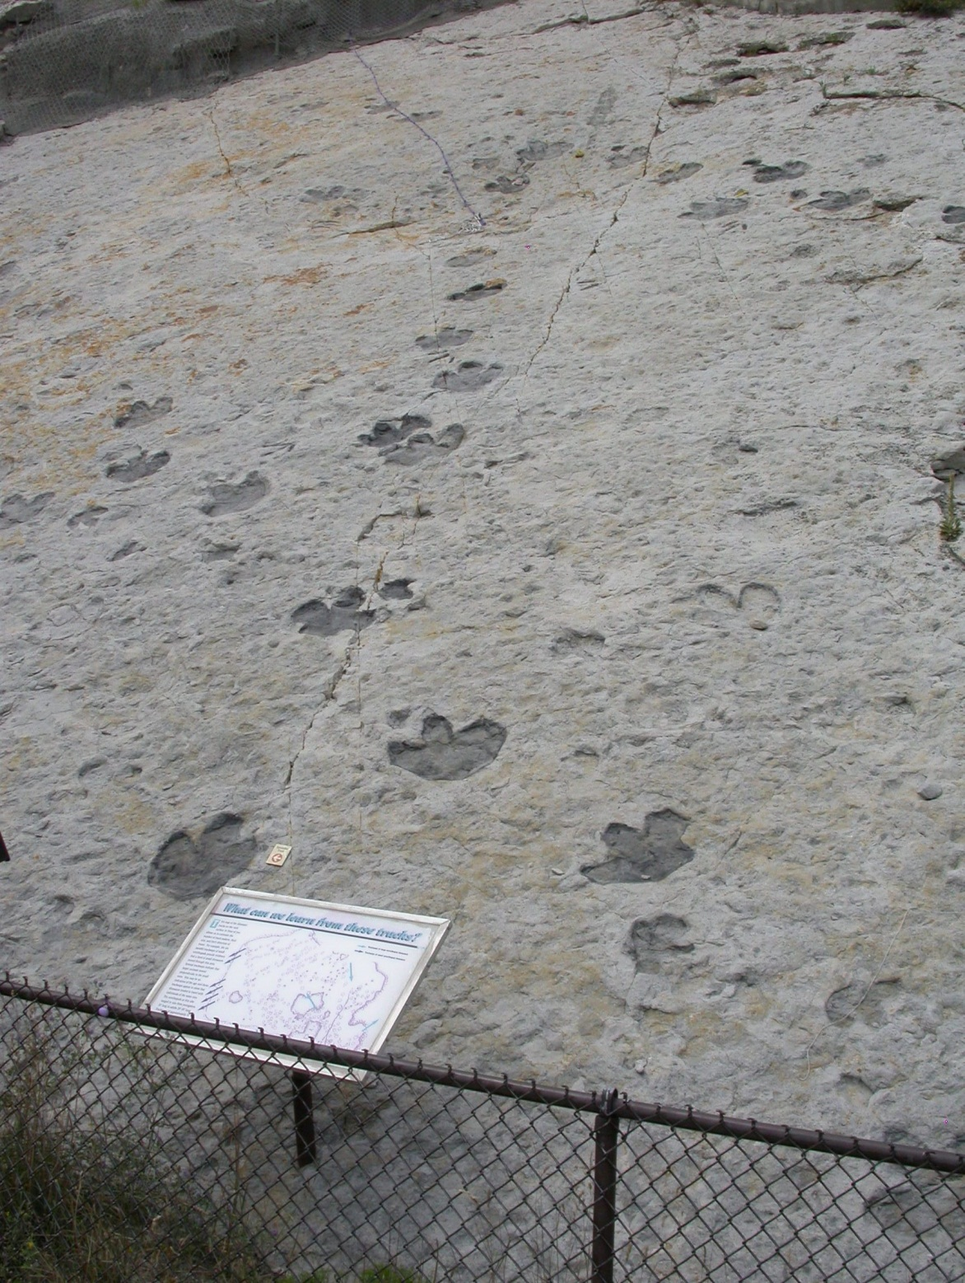
Dinosaur footprints, Dakota Sandstone, Colorado, USA

Slide 32
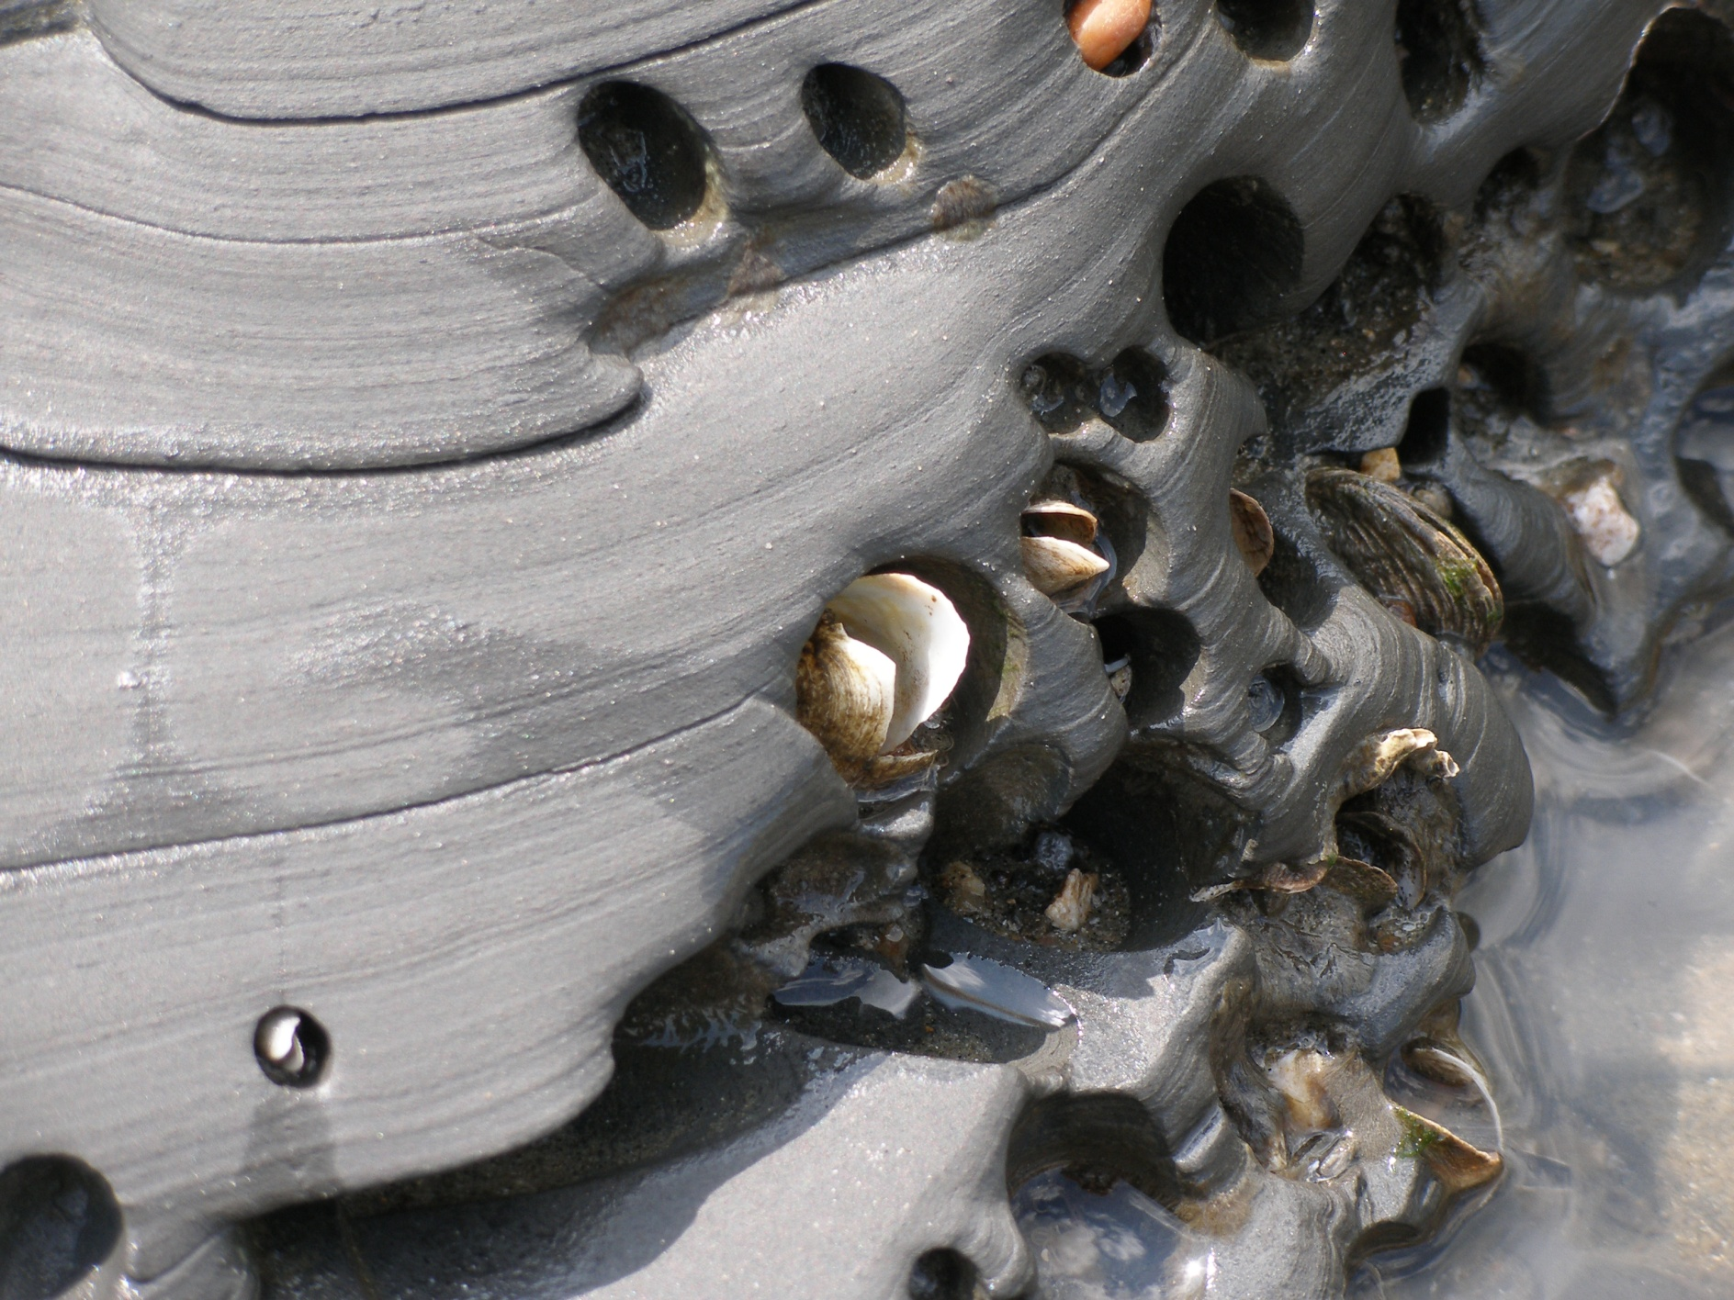
Living bivalves (common piddock), boring into hard rock, Lyme Regis, Dorset

Slide 33
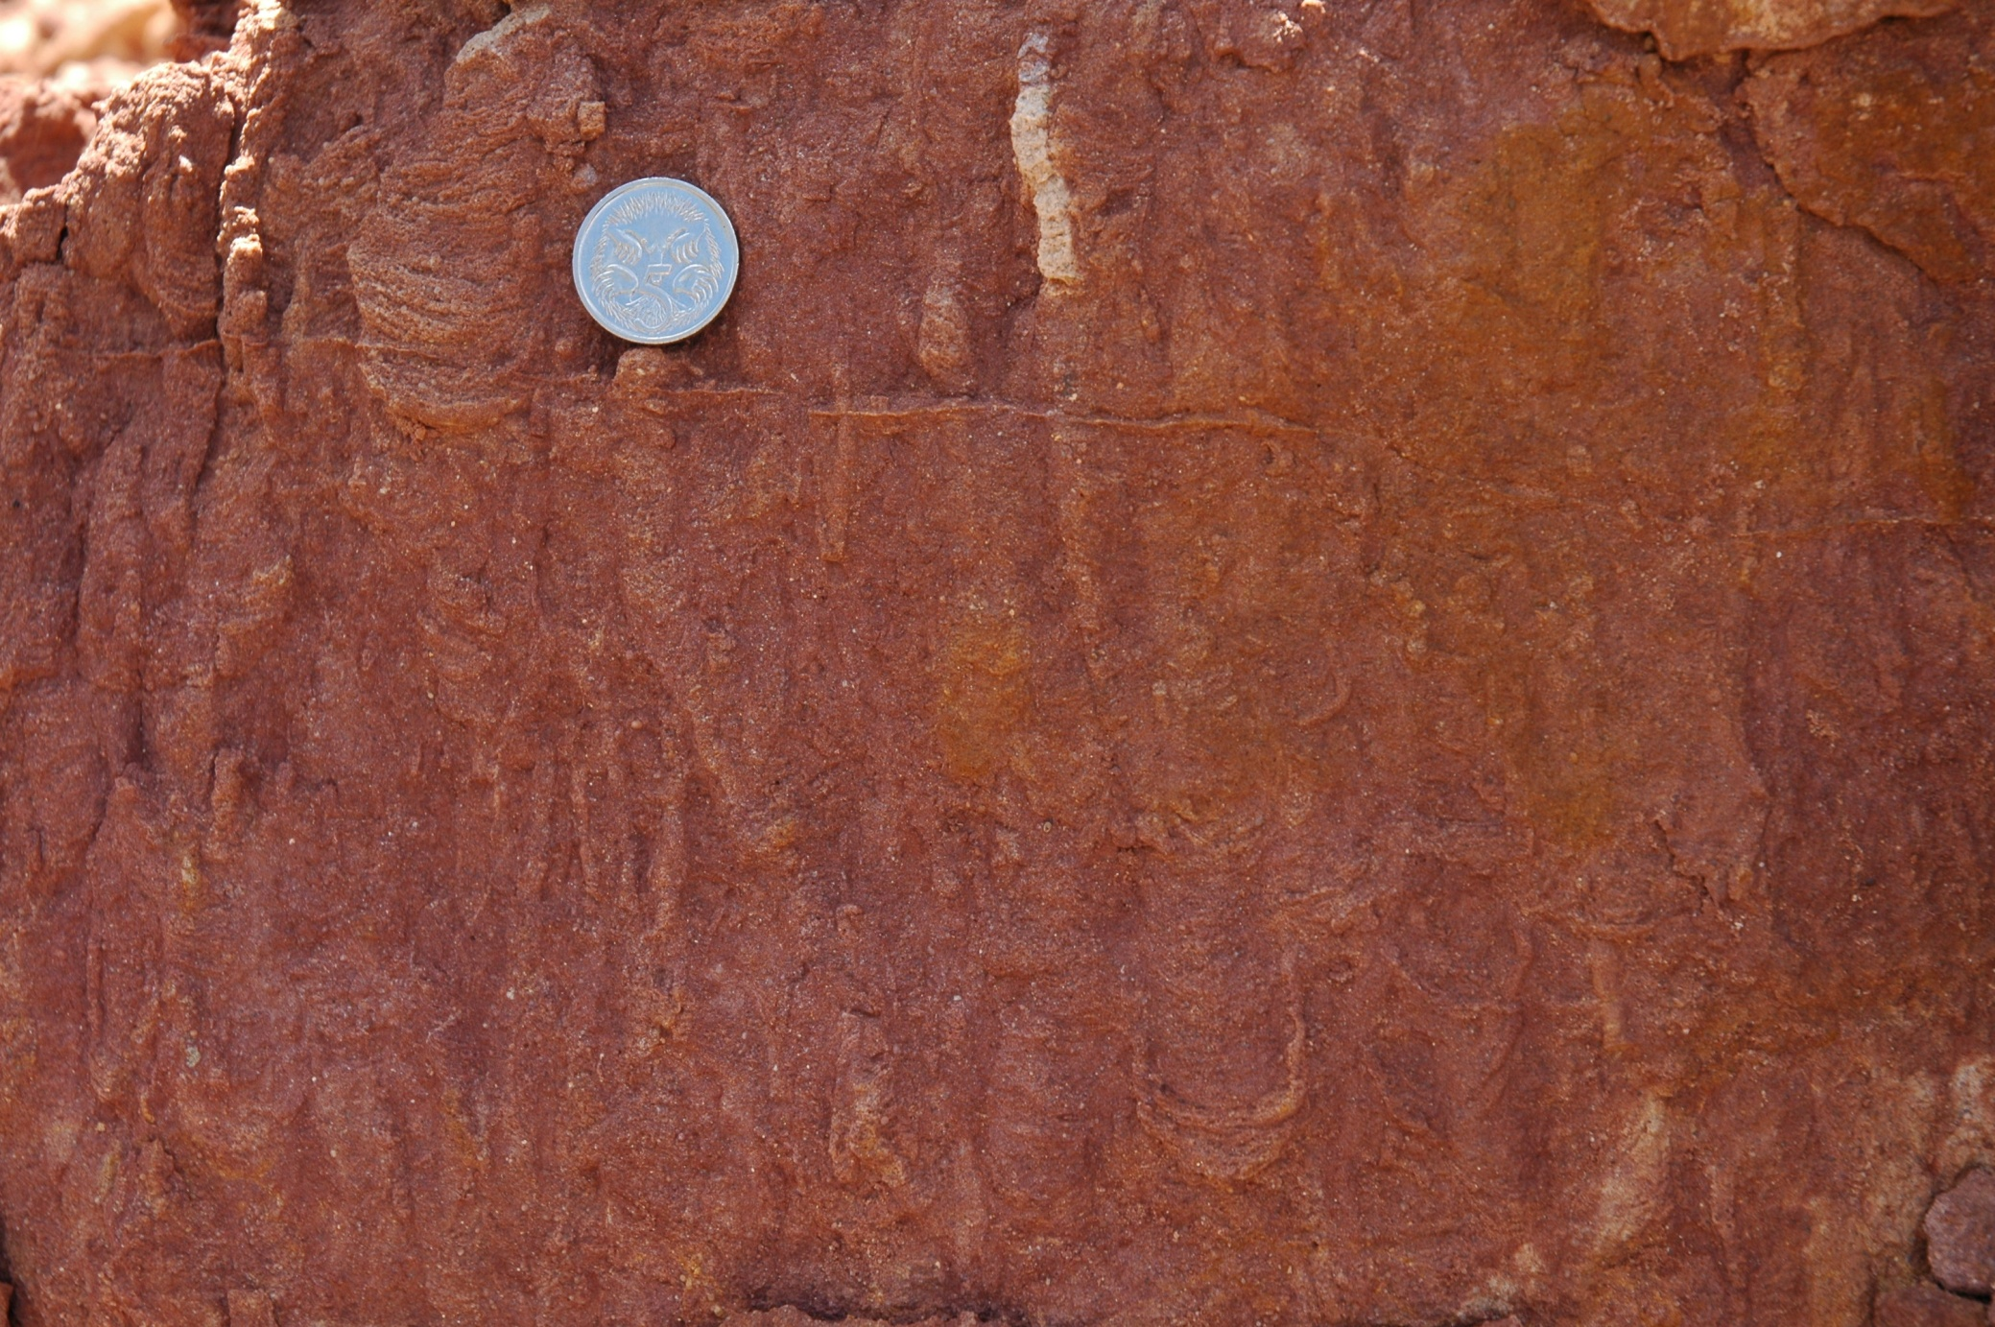
Diplocraterion burrows in lowermost Cambrian sediments, Brachilna Gorge, South Australia

Slide 35
Acknowledgment: Thank you to Dr John Nudds for the use of this lecture and the lovely images

